Slide 1

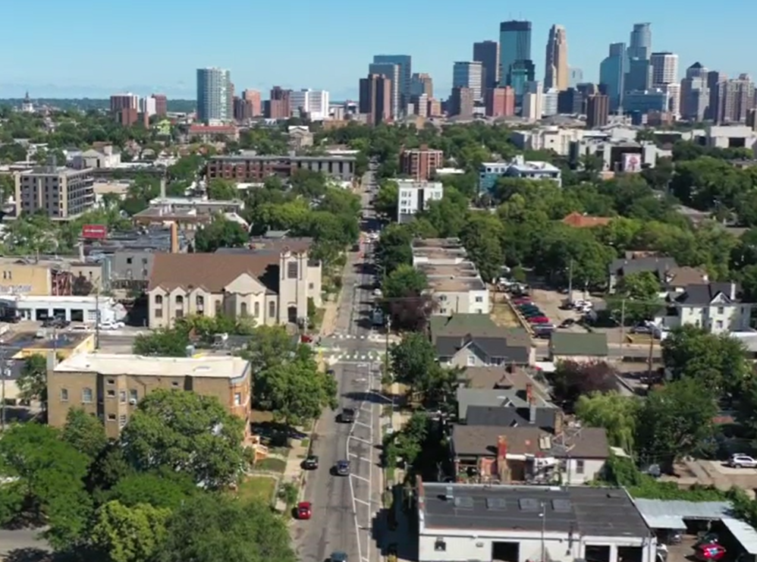

1st Ave S Reconstruction Project
E. Grant St – E. Franklin Ave.
Stakeholder Meeting
May 1st, 2026

Slide 2
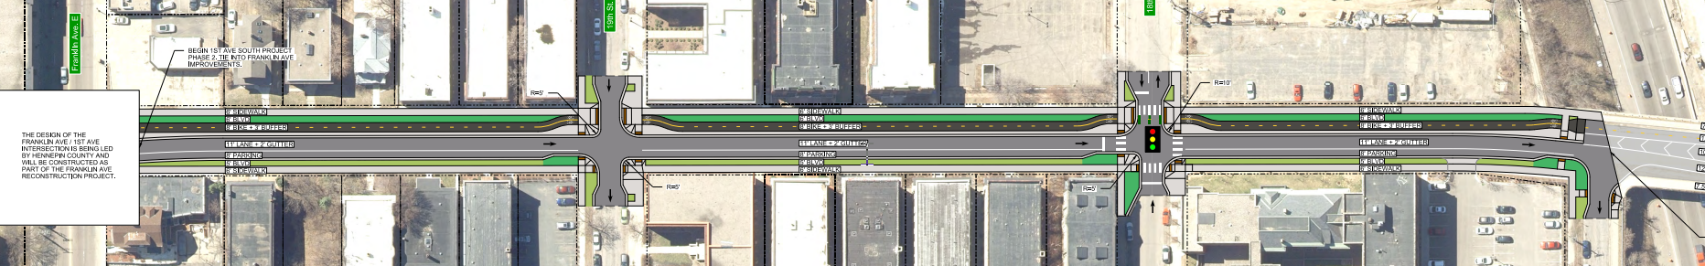
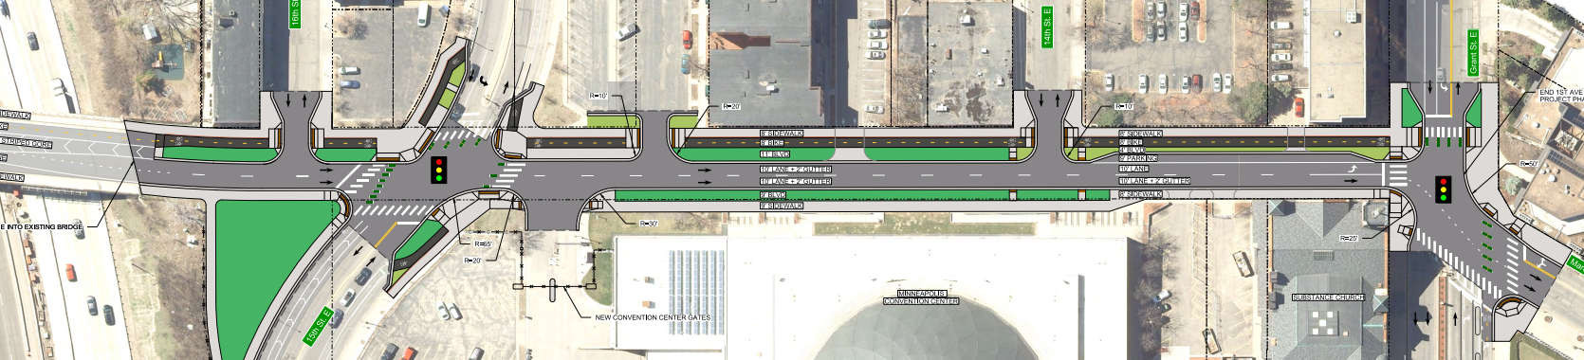
1st Ave S Reconstruction Project
Project Layout
Project Layout

Slide 3
1st Ave S Reconstruction Project
Current Activities
CenterPoint Energy – Upgrading gas mains and service connection.
Grant to 94 Bridge: Completed
94 Bridge to Franklin: In progress
  Centerpoint anticipates to be done in the week of 4th of May.
  To expect work with E 18th St. for Steel Pipe reroute that will be coordinated with City Contractor for 1st Ave S Reconstruction Project.
  Centerpoint Website: www.centerpointenergy.com/construction
    Stevens Square – Loring Heights Neighborhood
    Contact: (612) 542-6198 or mnconstruction@centerpointenergy.com
City Project – Construction in progress
Grant to 94 Bridge:
  Removals – in progress between North of I-94 Bridge to 14th St.
  Utility work – Sanitary Sewer Installation is in progress.
  Temporary access route provided for Substance, Event Center and Stradford Flats (Garbage pickup, & Parking Lot users)
18th St to South of I-94 Bridge:
  Staging & prep work - ongoing

Slide 4
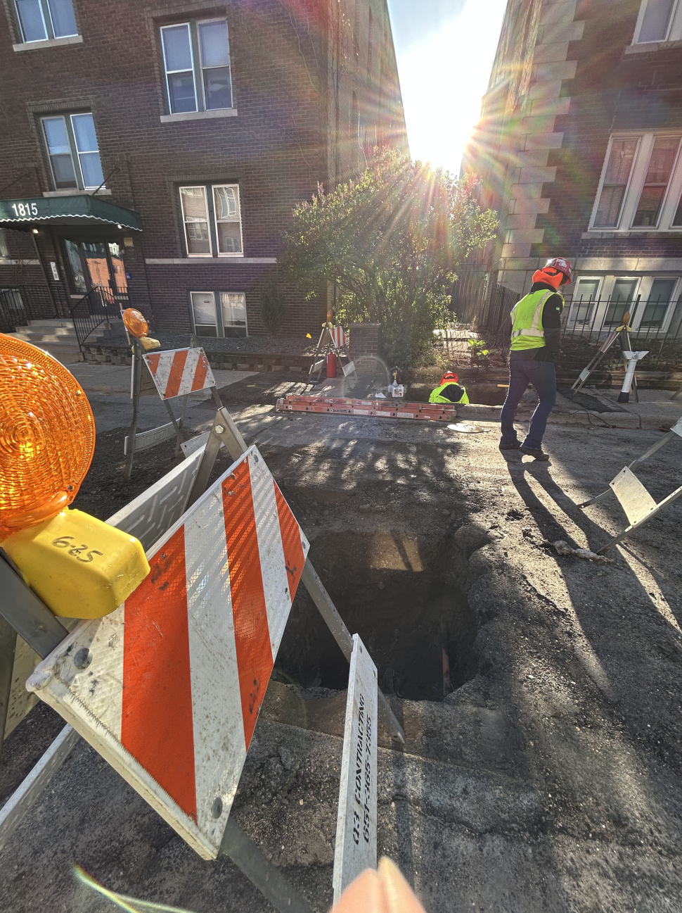
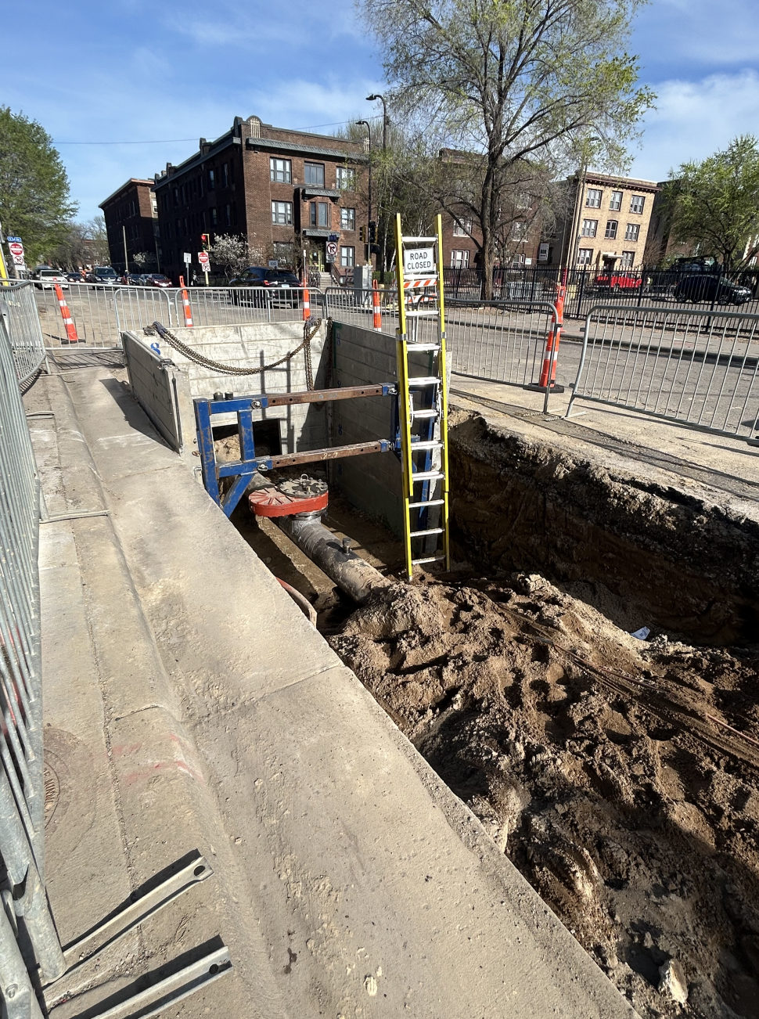
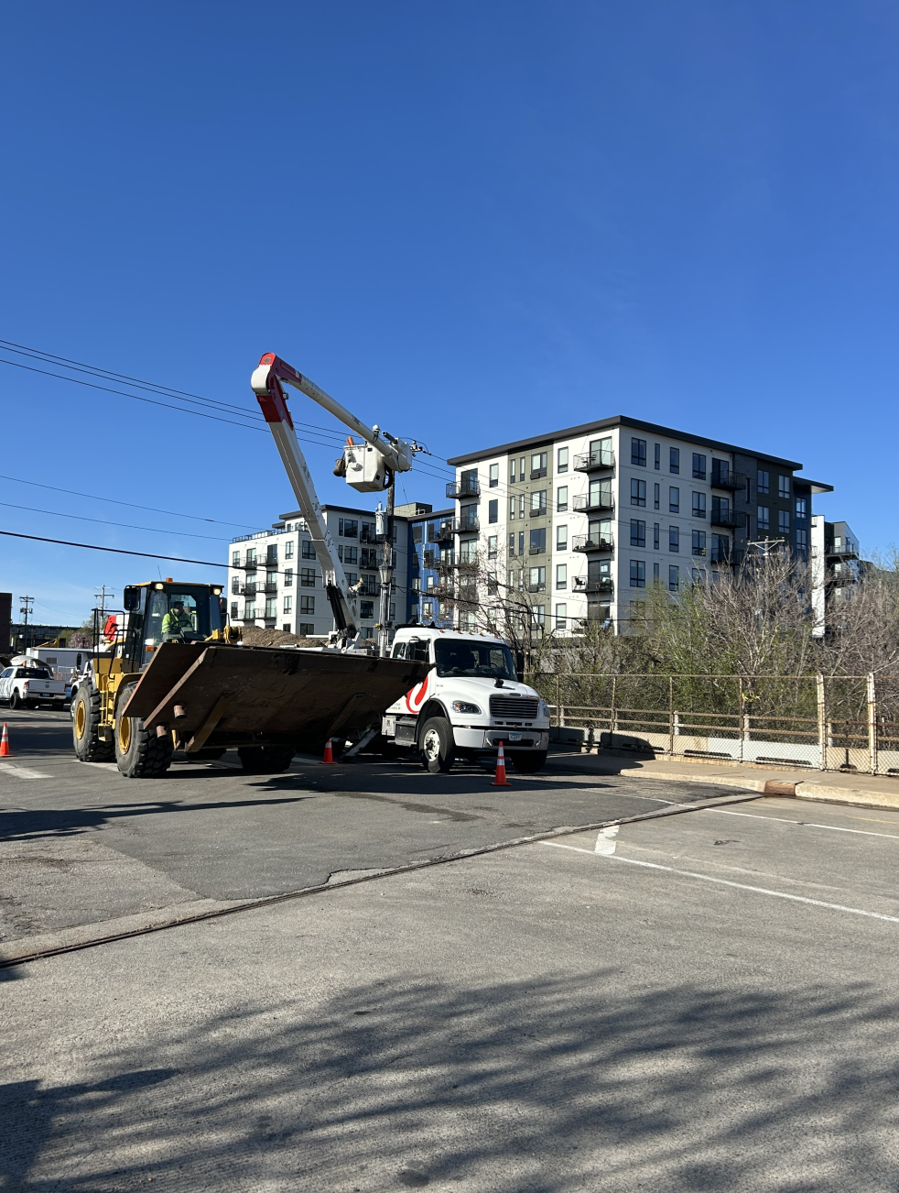
1st Ave S Reconstruction Project
  Franklin to South I-94 Bridge Activity

Slide 5
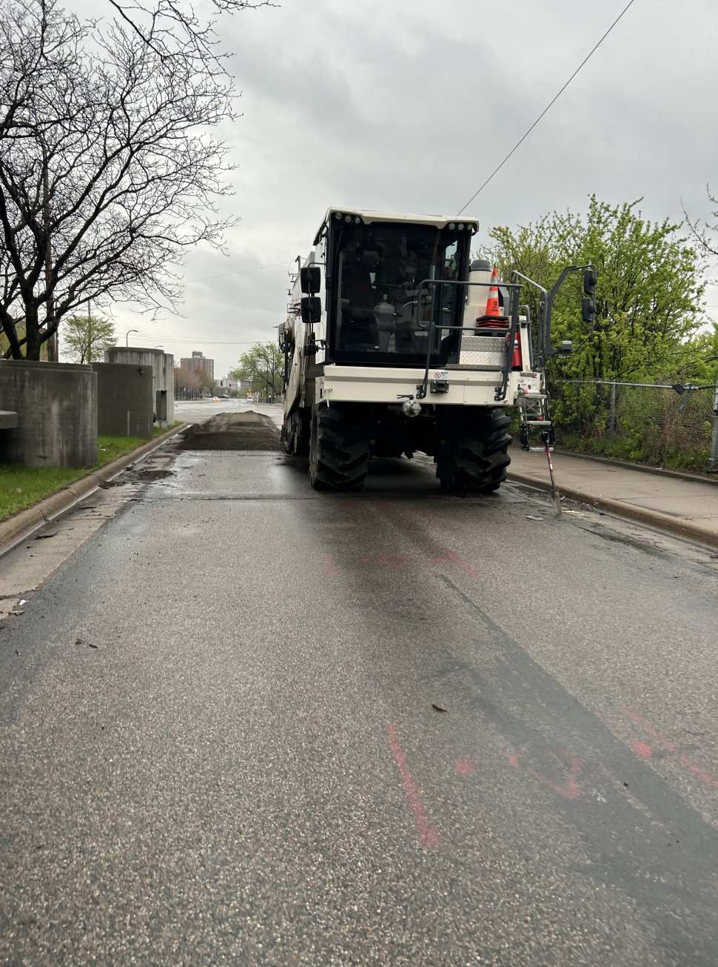
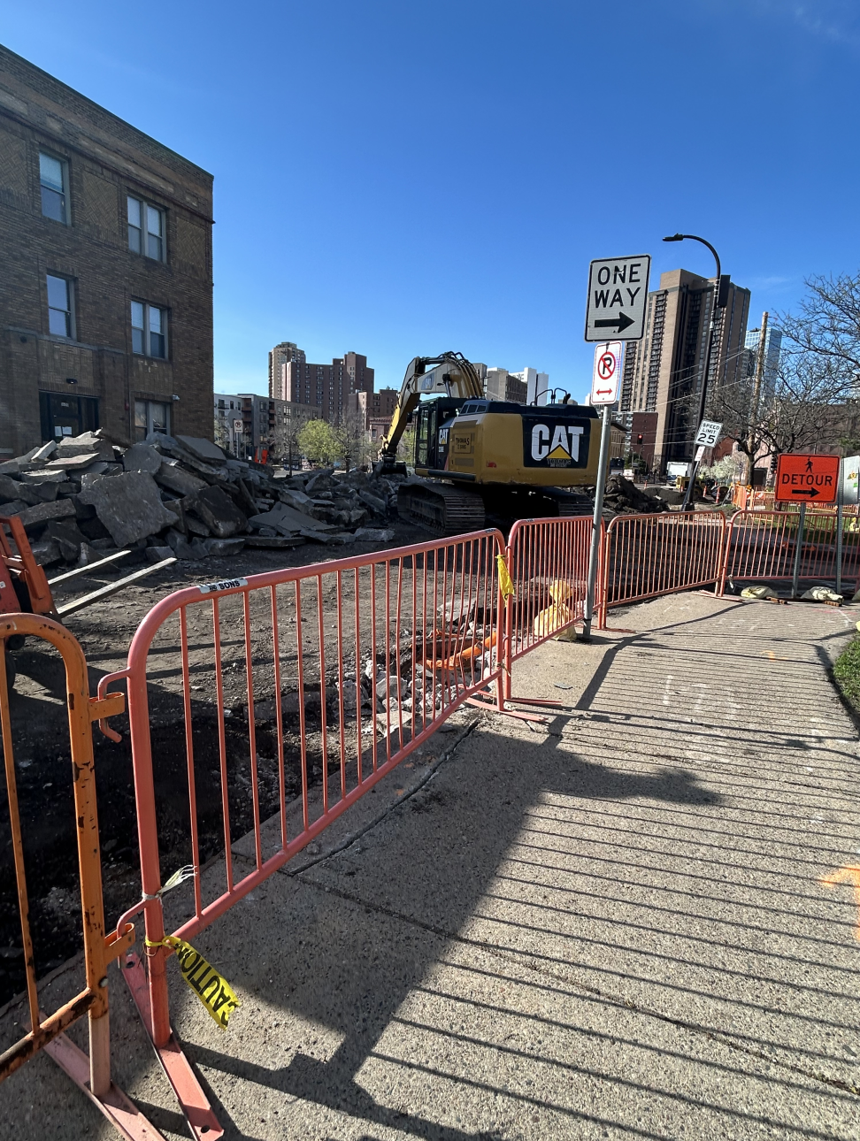
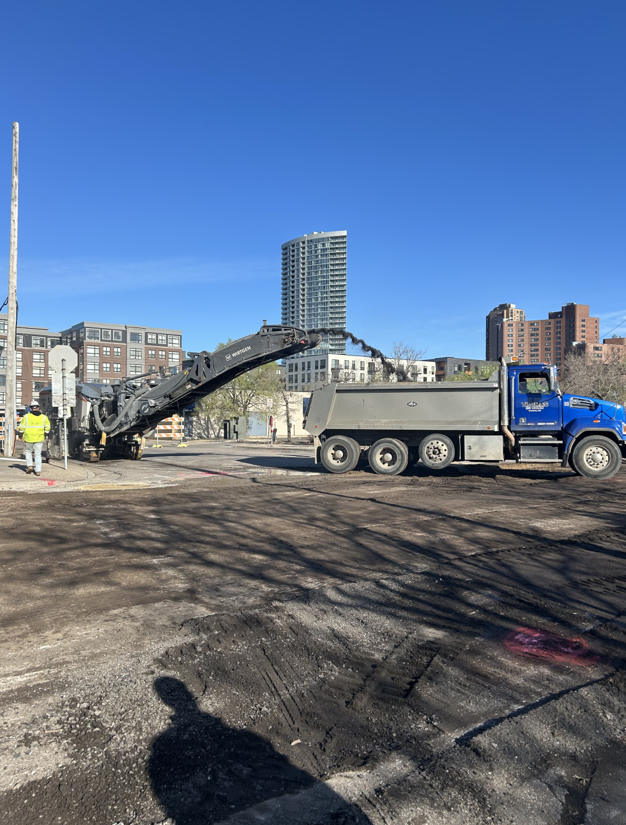
1st Ave S Reconstruction Project
  North of I-94 Bridge to Grant St. Activity

Slide 6
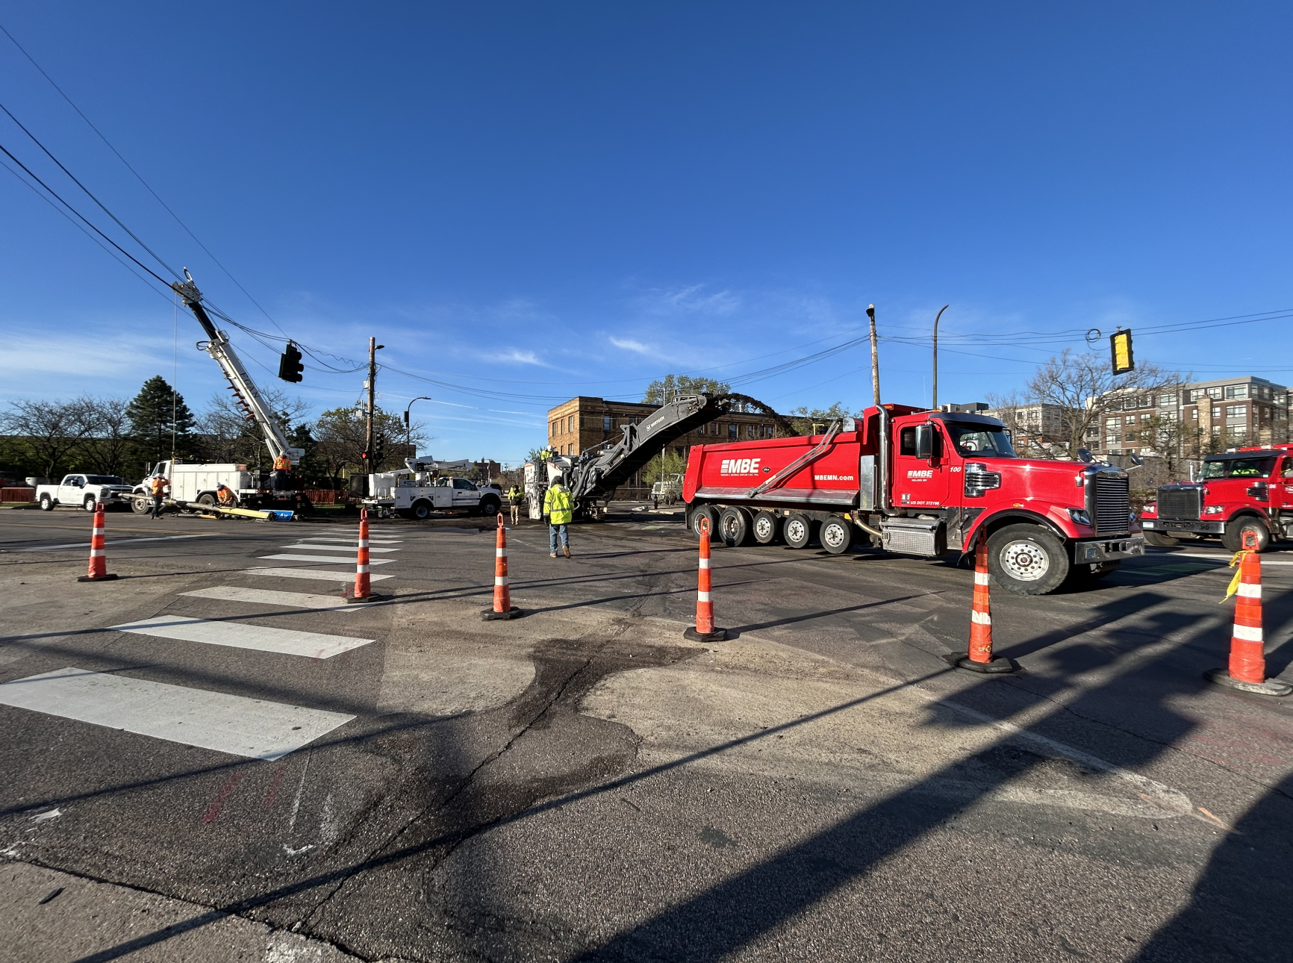
1st Ave S Reconstruction Project
Construction- What to Expect
Roadway Construction: In progress
  Large Construction Equipment
  Uneven ground due to removals and utility installation
  Disruption & Noise
  Dust
  Parking Closures
  Temporary Pedestrian Ramps
  Traffic Impacts
  Business Access
  Construction Substantial Completion: November 15, 2026

Slide 7
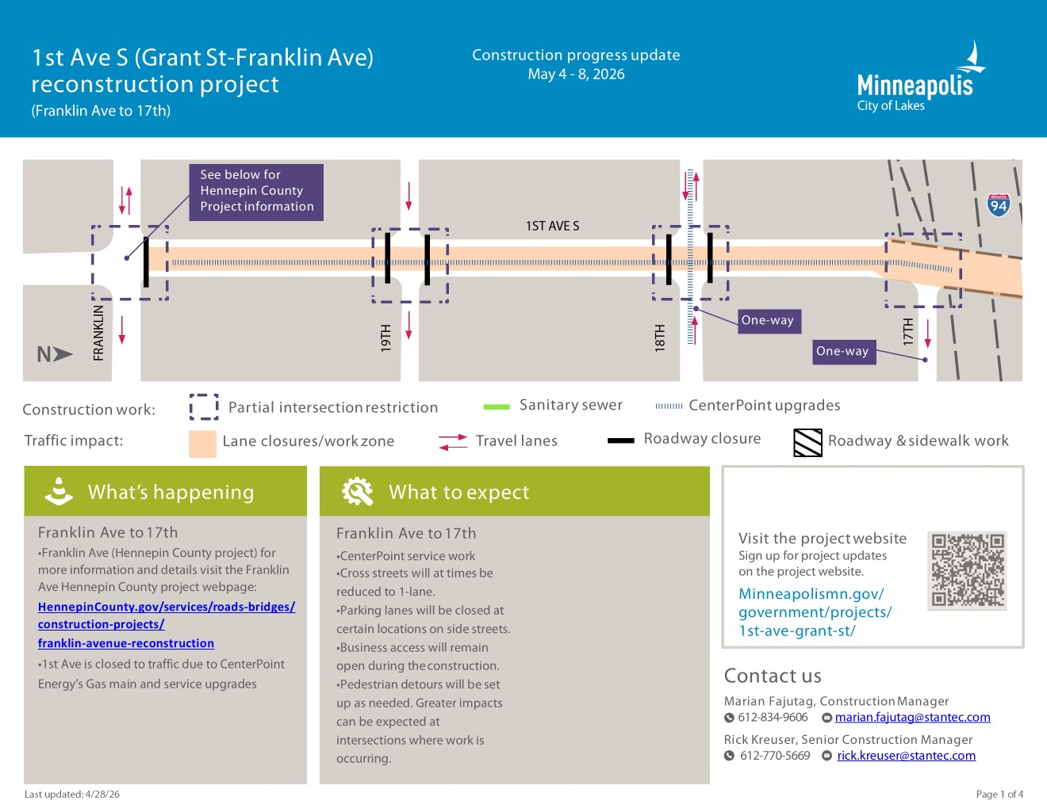

Slide 8
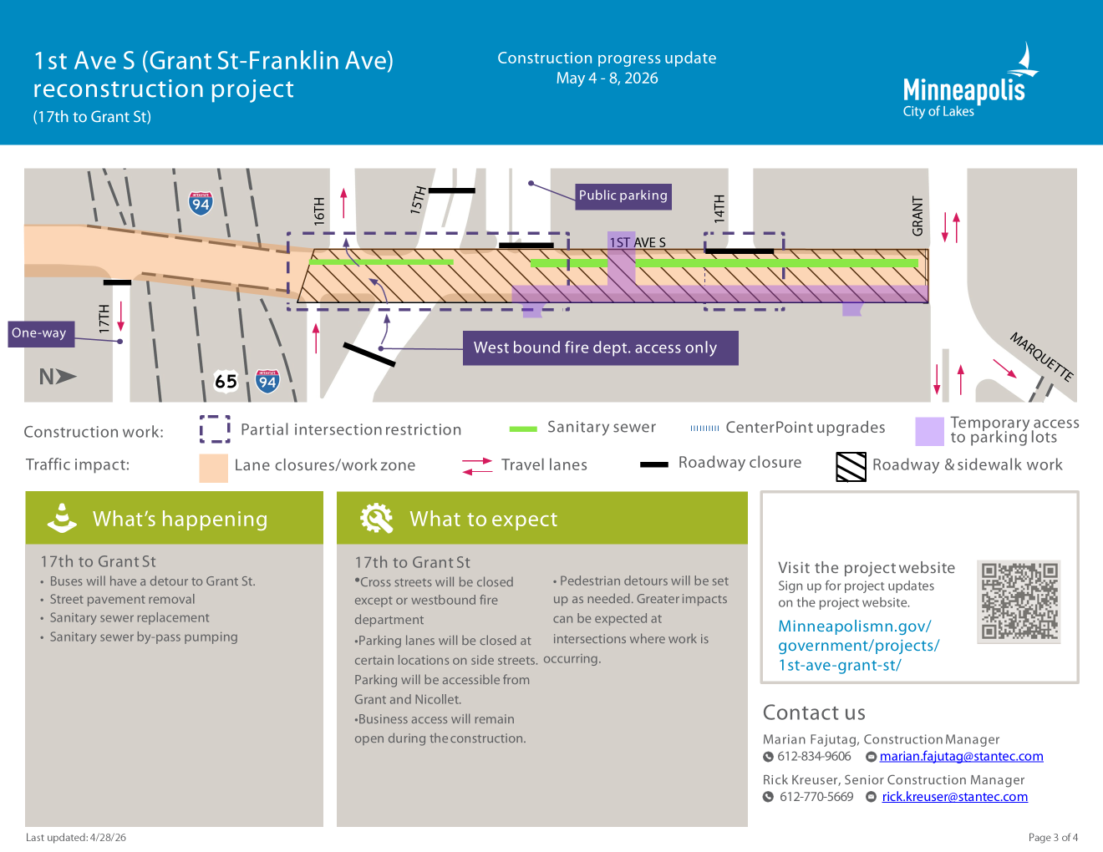

Slide 9
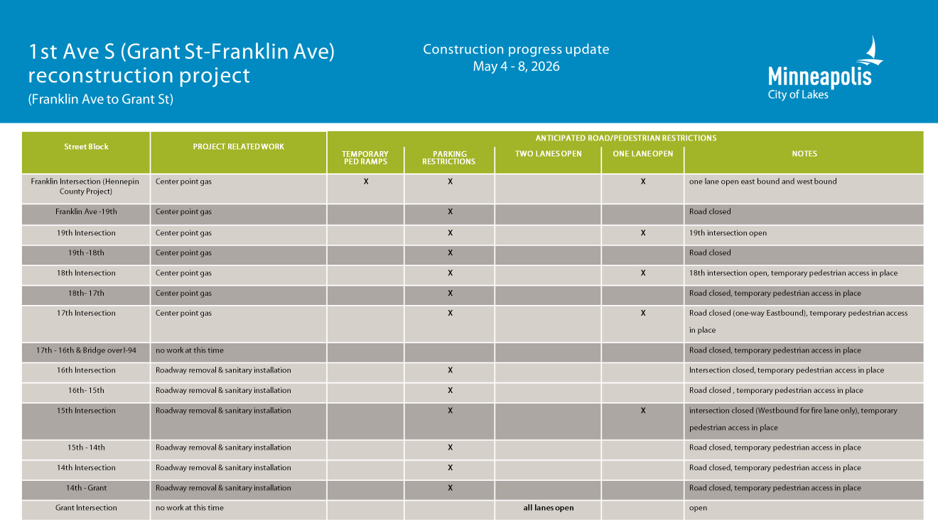

Slide 10
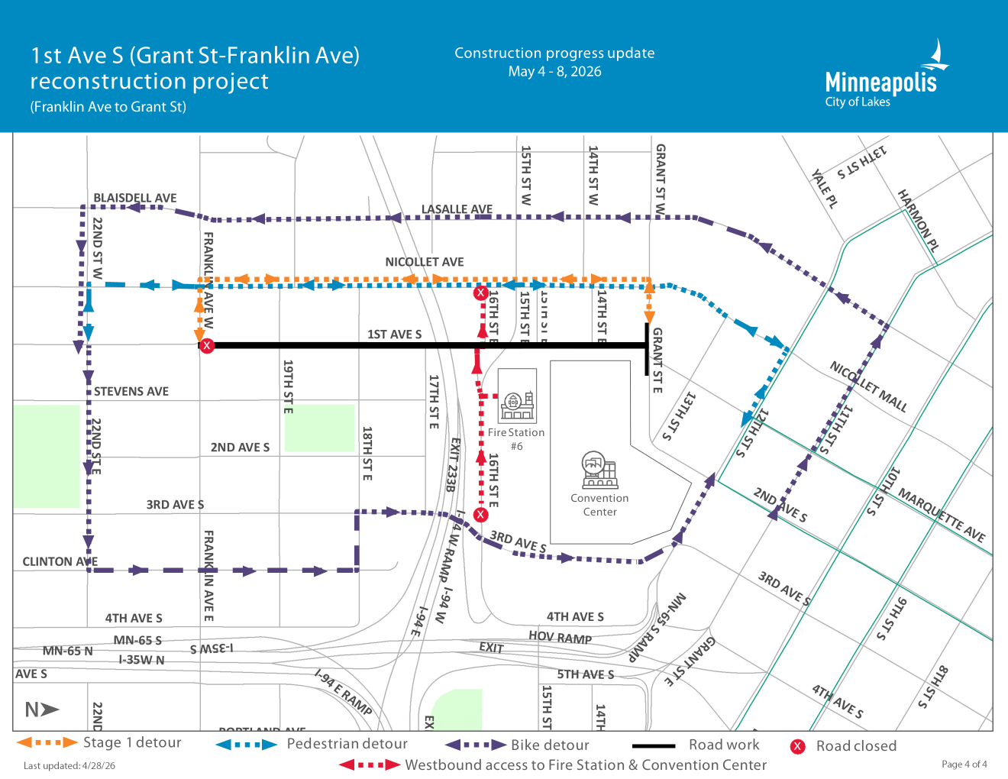
DETOUR ROUTES
(Vehicles, Bicycles and Pedestrians)

Slide 11
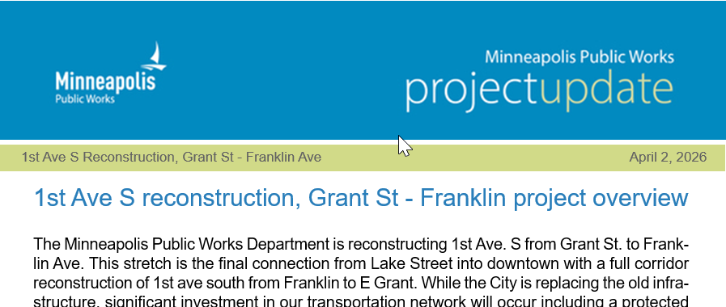
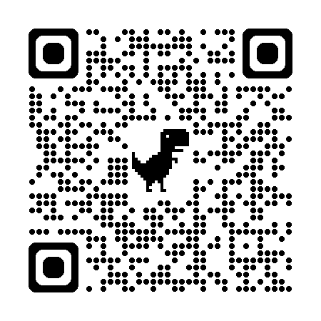
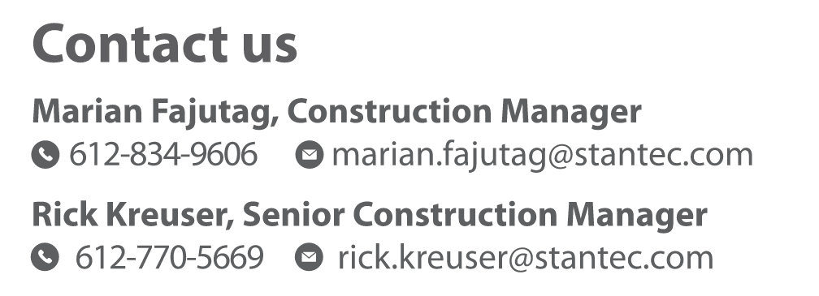
1st Ave S Reconstruction Project
Communications
Weekly Friday Meetings 10:00 am – 11:00 am
Weekly Email Updates (GovDelivery)
Neighborhood Meetings
One-on-One Site Visits
Website – Sign up for Updates, Project Engineer & Construction Manager Contact Information
https://www.minneapolismn.gov/government/projects/1st-ave-grant-st/

Slide 12
1st Ave S Reconstruction Project
Questions & Open Discussion

