Slide 1
Richfield Road Sidewalk Gap
December 7, 2023

Slide 2
Project Overview
Goals:
Provide needed ADA compliant facility
Connect path to future transit stops
Limit impacts to existing trees and park facilities
Scope:
Sidewalk gap located on the south side of Richfield Road
Provide an accessible path from existing paths to future Metro Transit E line BRT stations located on both sides of the road

Slide 3
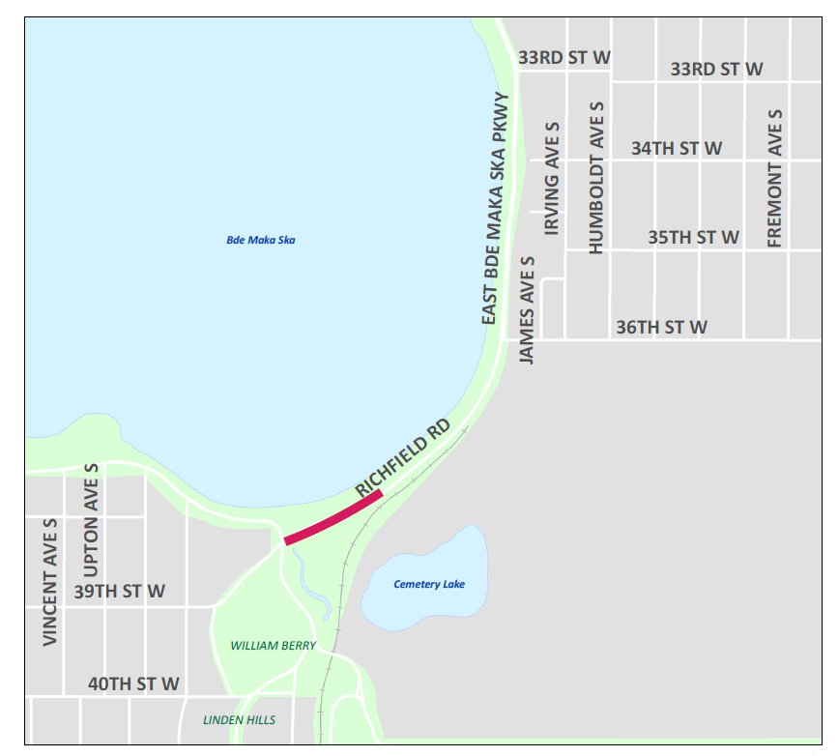
Location - Map
Located along Richfield Road
Section between William Berry Parkway and future E line bus stop

Slide 4
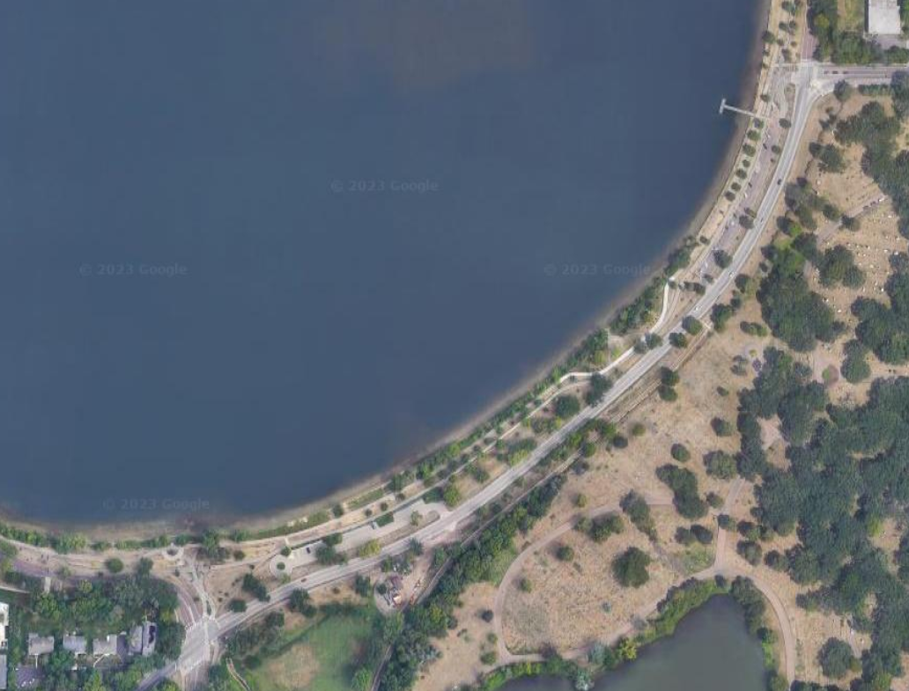
Location – Satellite Image
Future E line transit stops & connection
to existing and future paths
East/South of Richfield Road
Notes:
https://www.google.com/maps/@44.9340244,-93.3089621,206m/data=!3m1!1e3?entry=ttu

Slide 5
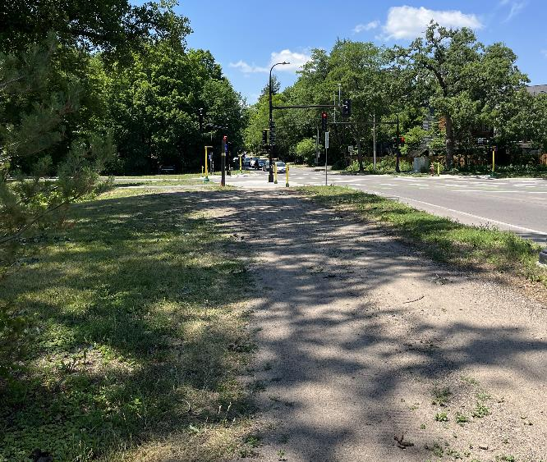
Existing Conditions – William Berry Parkway

Slide 6
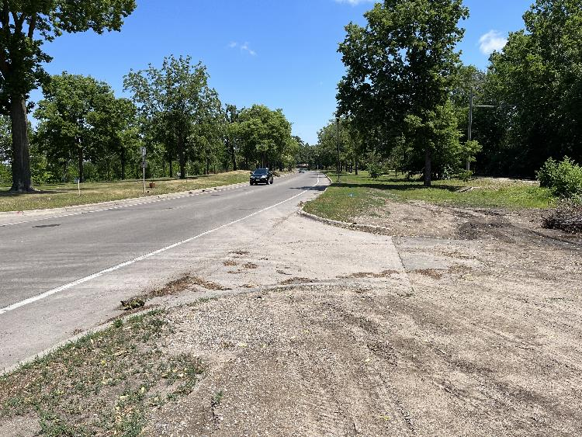
Existing Conditions – Future E Line Stops Area

Slide 7
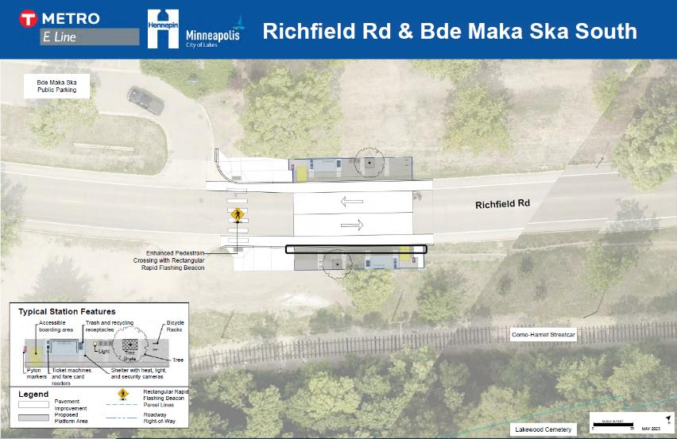
Metro Transit E Line Stations 60% Design
Future sidewalk to trails near Bde Maka Ska
Future path to William Berry Parkway

Slide 8
Design Considerations
Facility type
Sidewalk, shared use path, etc.
Environment & context
Trees, other right-of-way constraints, etc.
Cost limitations

Slide 9
Timeline of Project
September 2023 – March 2024
Engagement, coordination with MPRB and Metro Transit, and concept layout
Outcome: finalize concept layout
April 2024 – December 2024
Coordination with detailed engineering work
Outcome: finalize project design
2025
Construction of sidewalk gap project and completion

Slide 10
Discussion Questions
What type of path would you prefer (walking, biking, both)?
What does a successful project look like to you?

Slide 11
Contact Information
Gustave Stewart, Associate Transportation Planner
gustave.stewart@minneapolismn.gov

