Slide 1
Johnson St NE / 35W Intersection Improvements Project Introduction

Slide 2
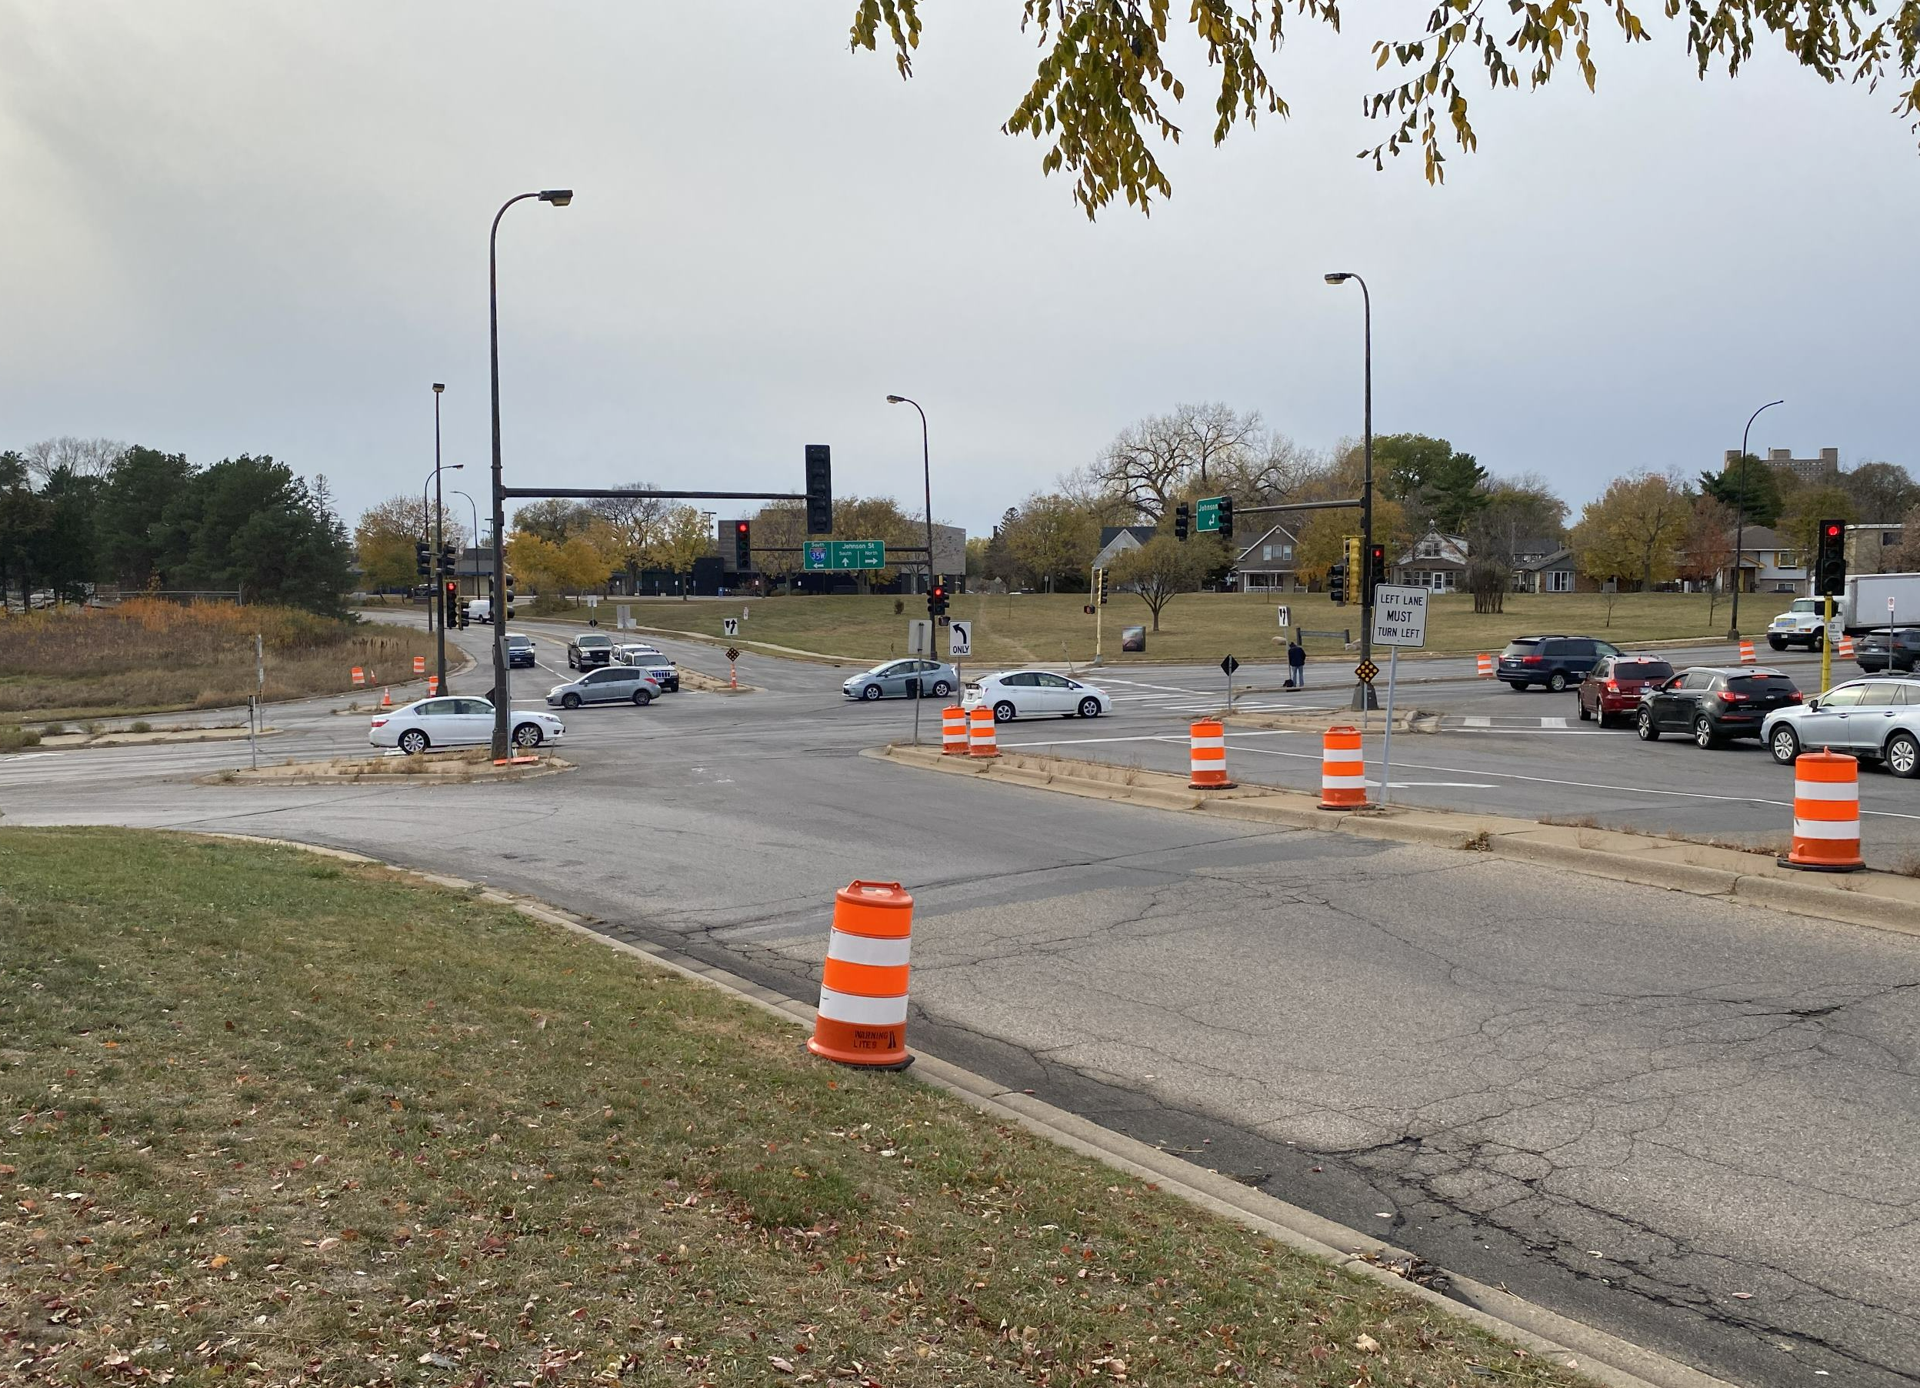
Agenda
Project Overview and Goals
Policy Guidance
Existing Conditions and Nearby Projects
Analysis and Design Options
Next Steps
Stay Involved / Questions

Slide 3
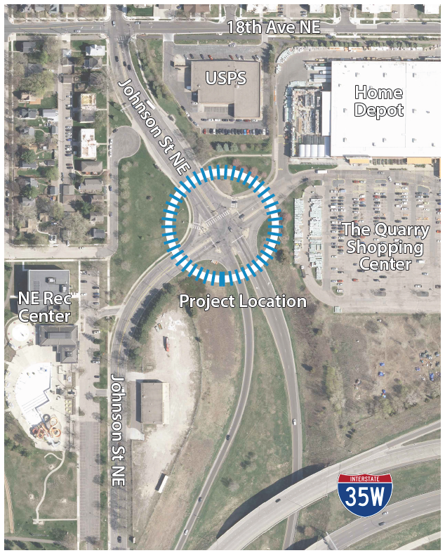
Project Overview
What?
Reconstruction of the intersection of Johnson St NE / I35W Ramps / Quarry Access
Why?
To improve the safety, comfort and travel experience for all users
When?
Planning and design – 2022-2024
Construction planned – 2024 or 2025

Slide 4
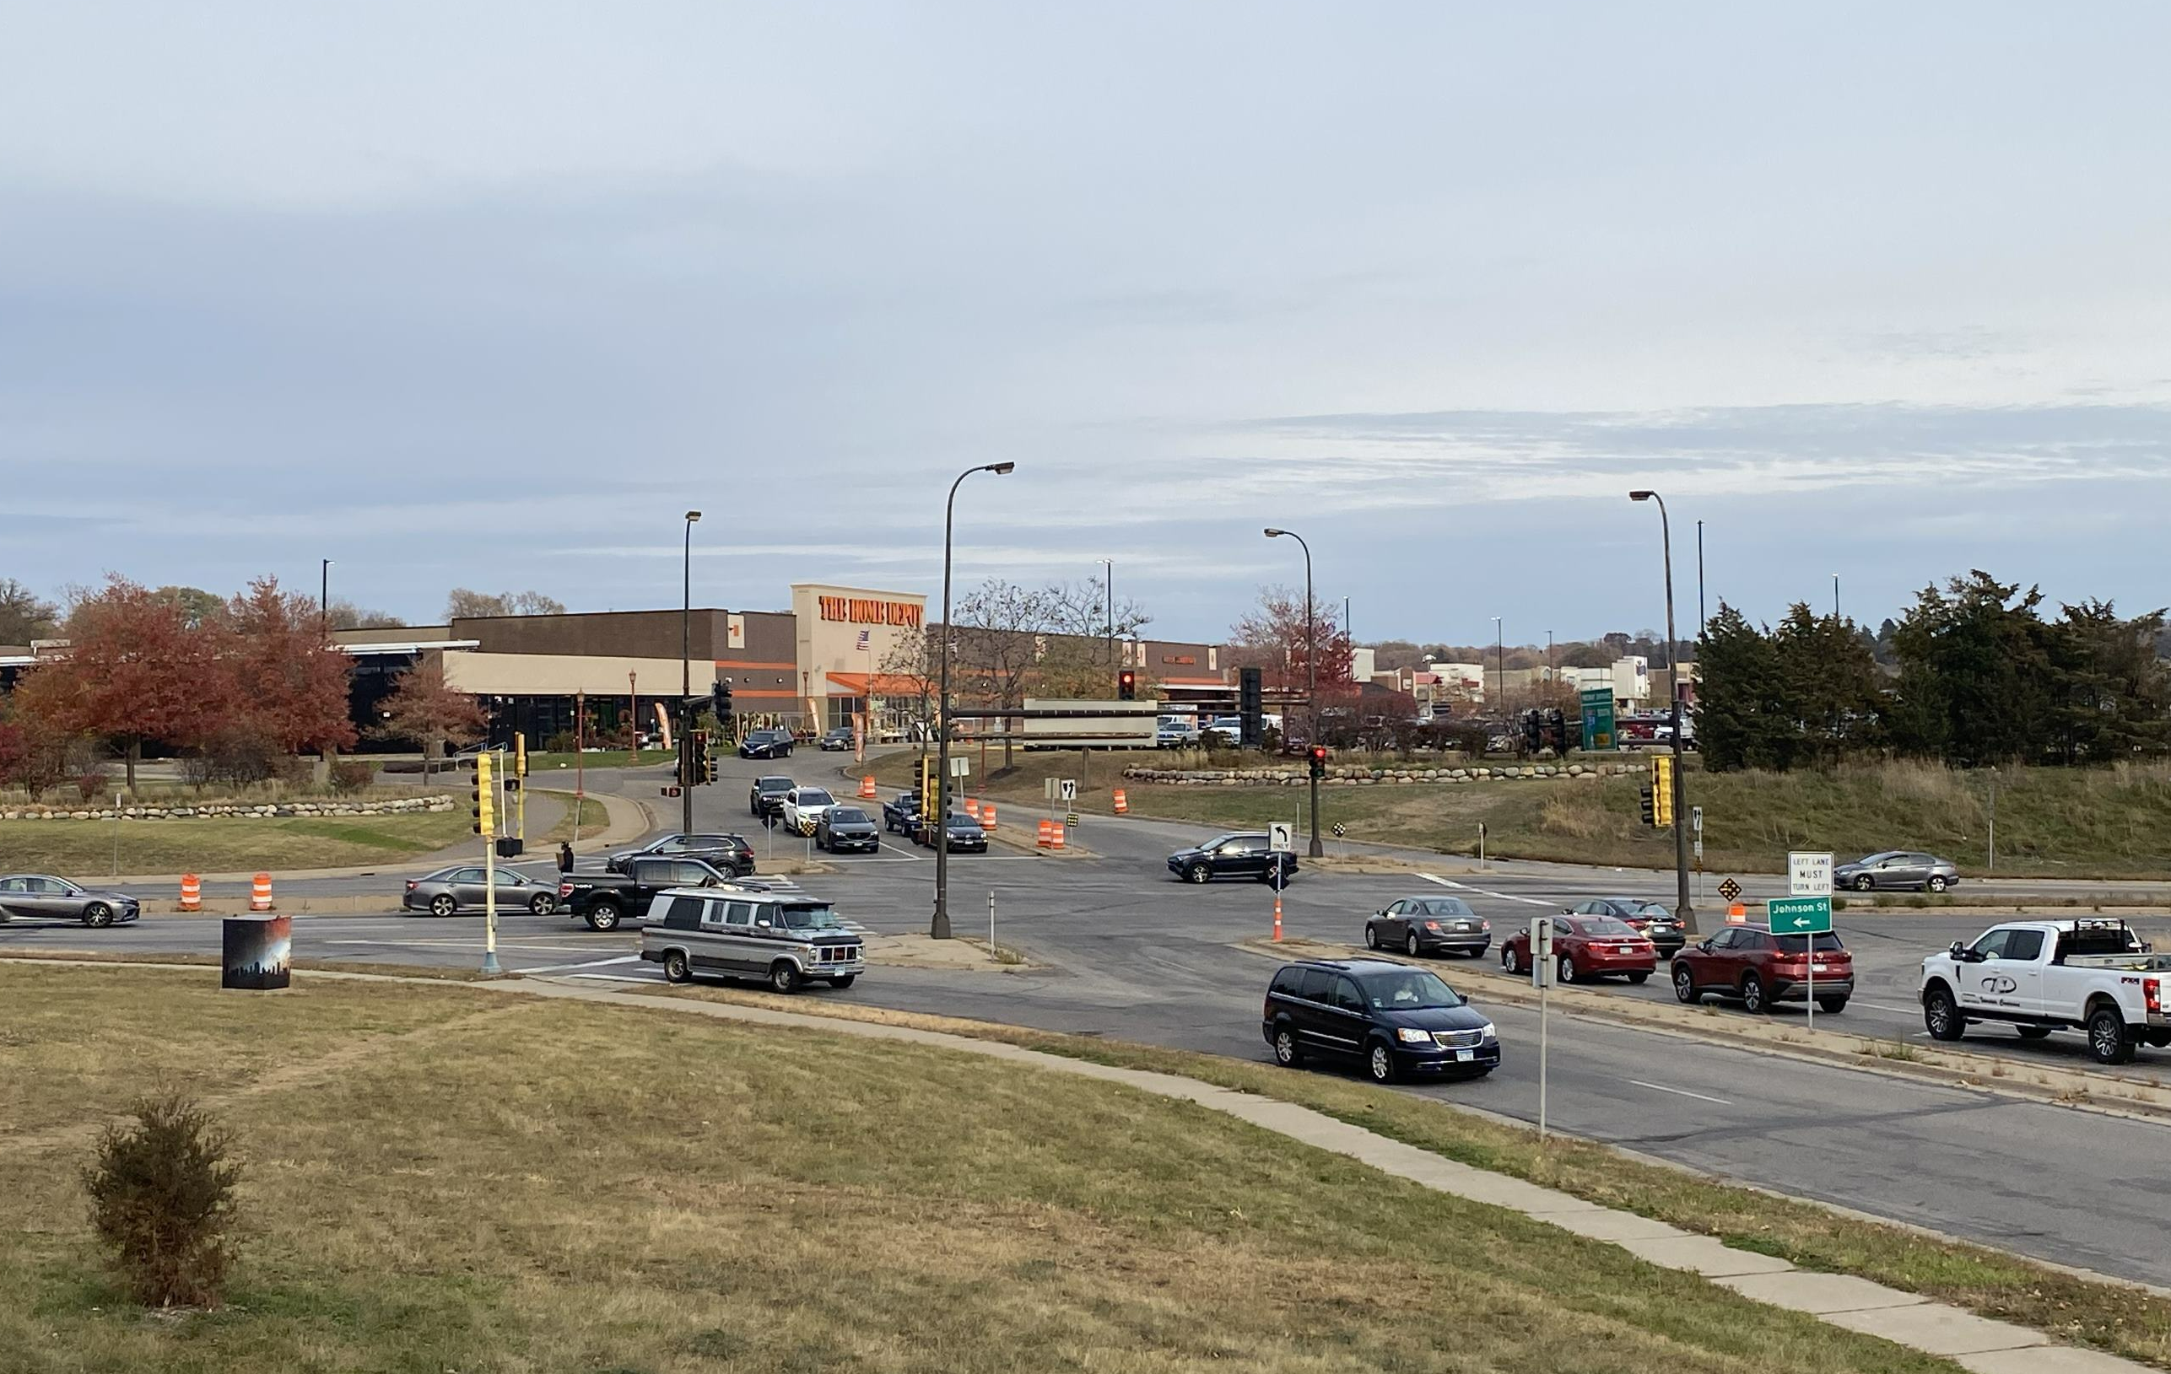
Project Goals
Improve safety and comfort for
Improve design and operation
Replace and improve aging signals and pavement
Upgrade sidewalks, ramps, and crossings
Improve safety for bicyclists
Support current and future transit
Incorporate green stormwater infrastructure and sustainable landscaping
Notes:
Improve safety and comfort for all people using the intersection
Improve the design and operation of the intersection
Replace and improve aging signals and pavement
Upgrade sidewalks, ramps, and crossings
Make is safer and more comfortable to bike through the area
Support current and future transit
Incorporate green stormwater infrastructure and sustainable landscaping

Slide 5
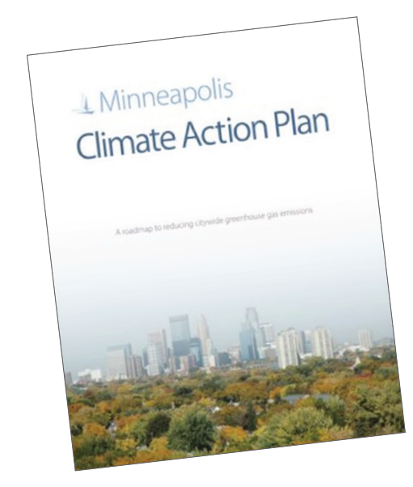
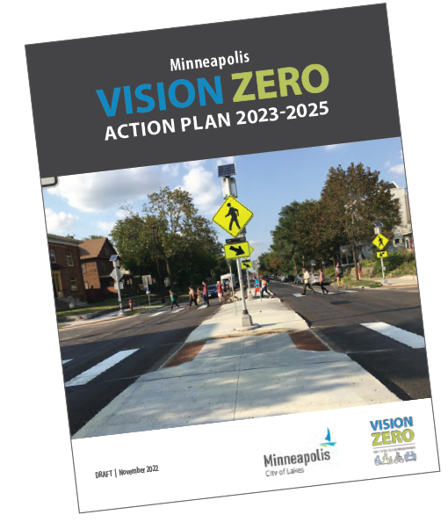
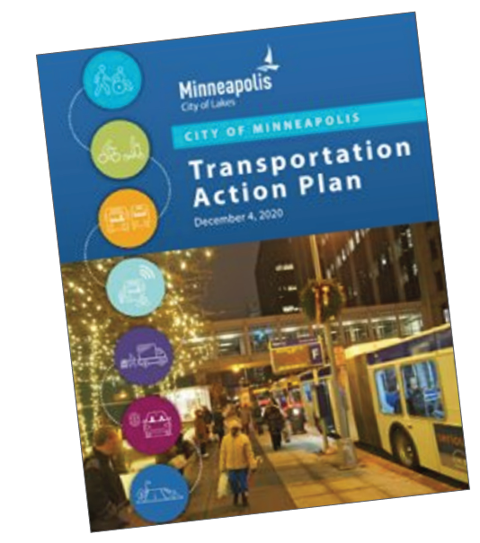
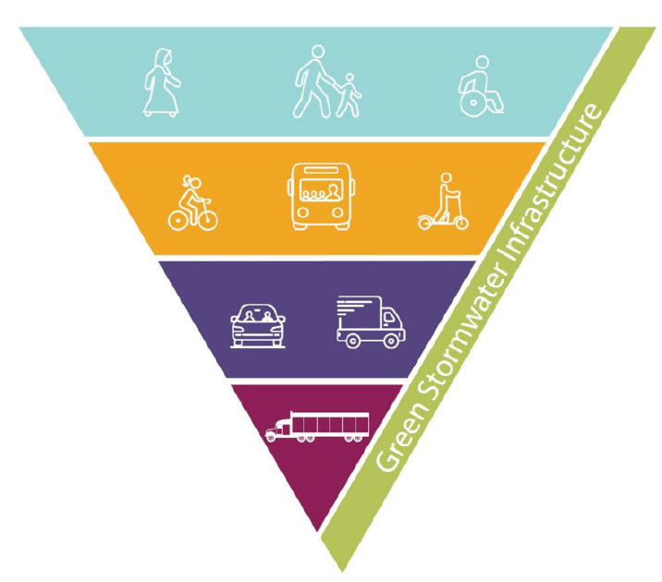
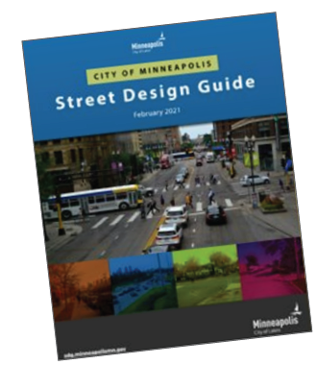
Policy Guidance
Plan / Policy | Goal / Outcome
Climate Action Plan (2013) | Reduce citywide greenhouse gas emissions by 30% by 2025 and 80% by 2050 (from 2006 emissions levels). Reduce transportation sector greenhouse gas emissions by more than 30% by 2030 (from 2018 levels).
Vision Zero Action Plan (2017) | Eliminate traffic related deaths and severe injuries on City streets by 2027.
Transportation Action Plan (TAP) (2020) | By 2030, 60 percent of trips will be taken by means other than a car (walking, biking/micromobility, or taking transit).
Complete Streets Policy (2021) | A modal priority framework that prioritizes people as they walk, roll, bicycle, and take transit over driving, deliveries, and parking.
Street Design Guide (2021) | Institutionalize the TAP, Complete Streets Policy, Vision Zero commitment, greenhouse gas emission reduction goal, commitment to racial justice, and stormwater management requirements through the design of the right of way.

Slide 6
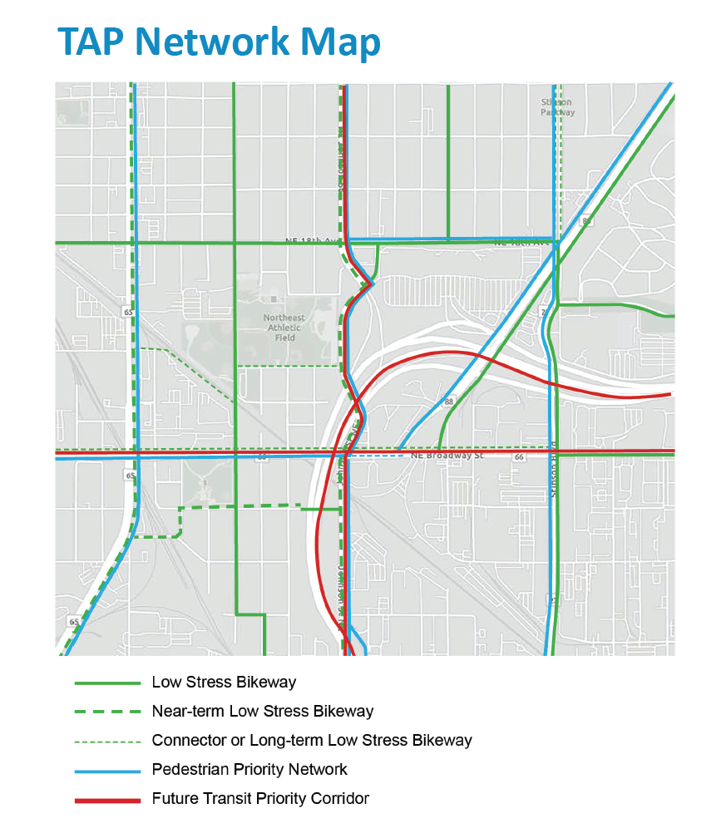
City Policy Supports:
Making bikeway connections for people of all ages and abilities
Improving the safety and comfort of people walking
Supporting transit to and through the intersection (currently served by Routes 4, 10, & 30)
PROJECT LOCTION

Slide 7
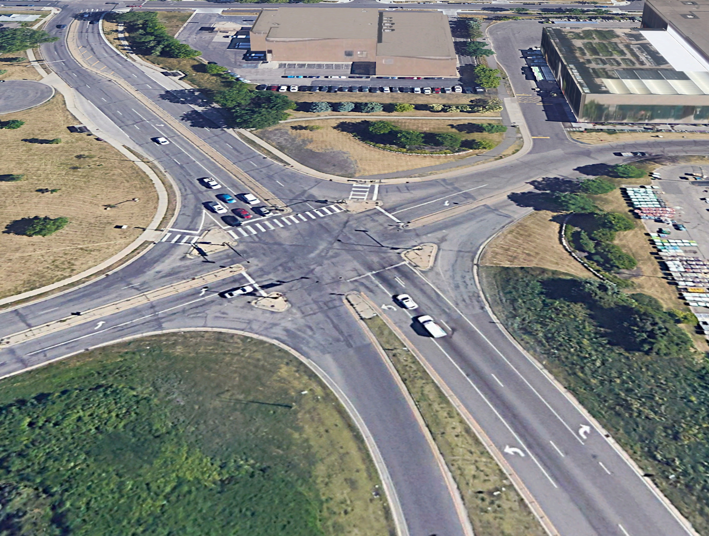
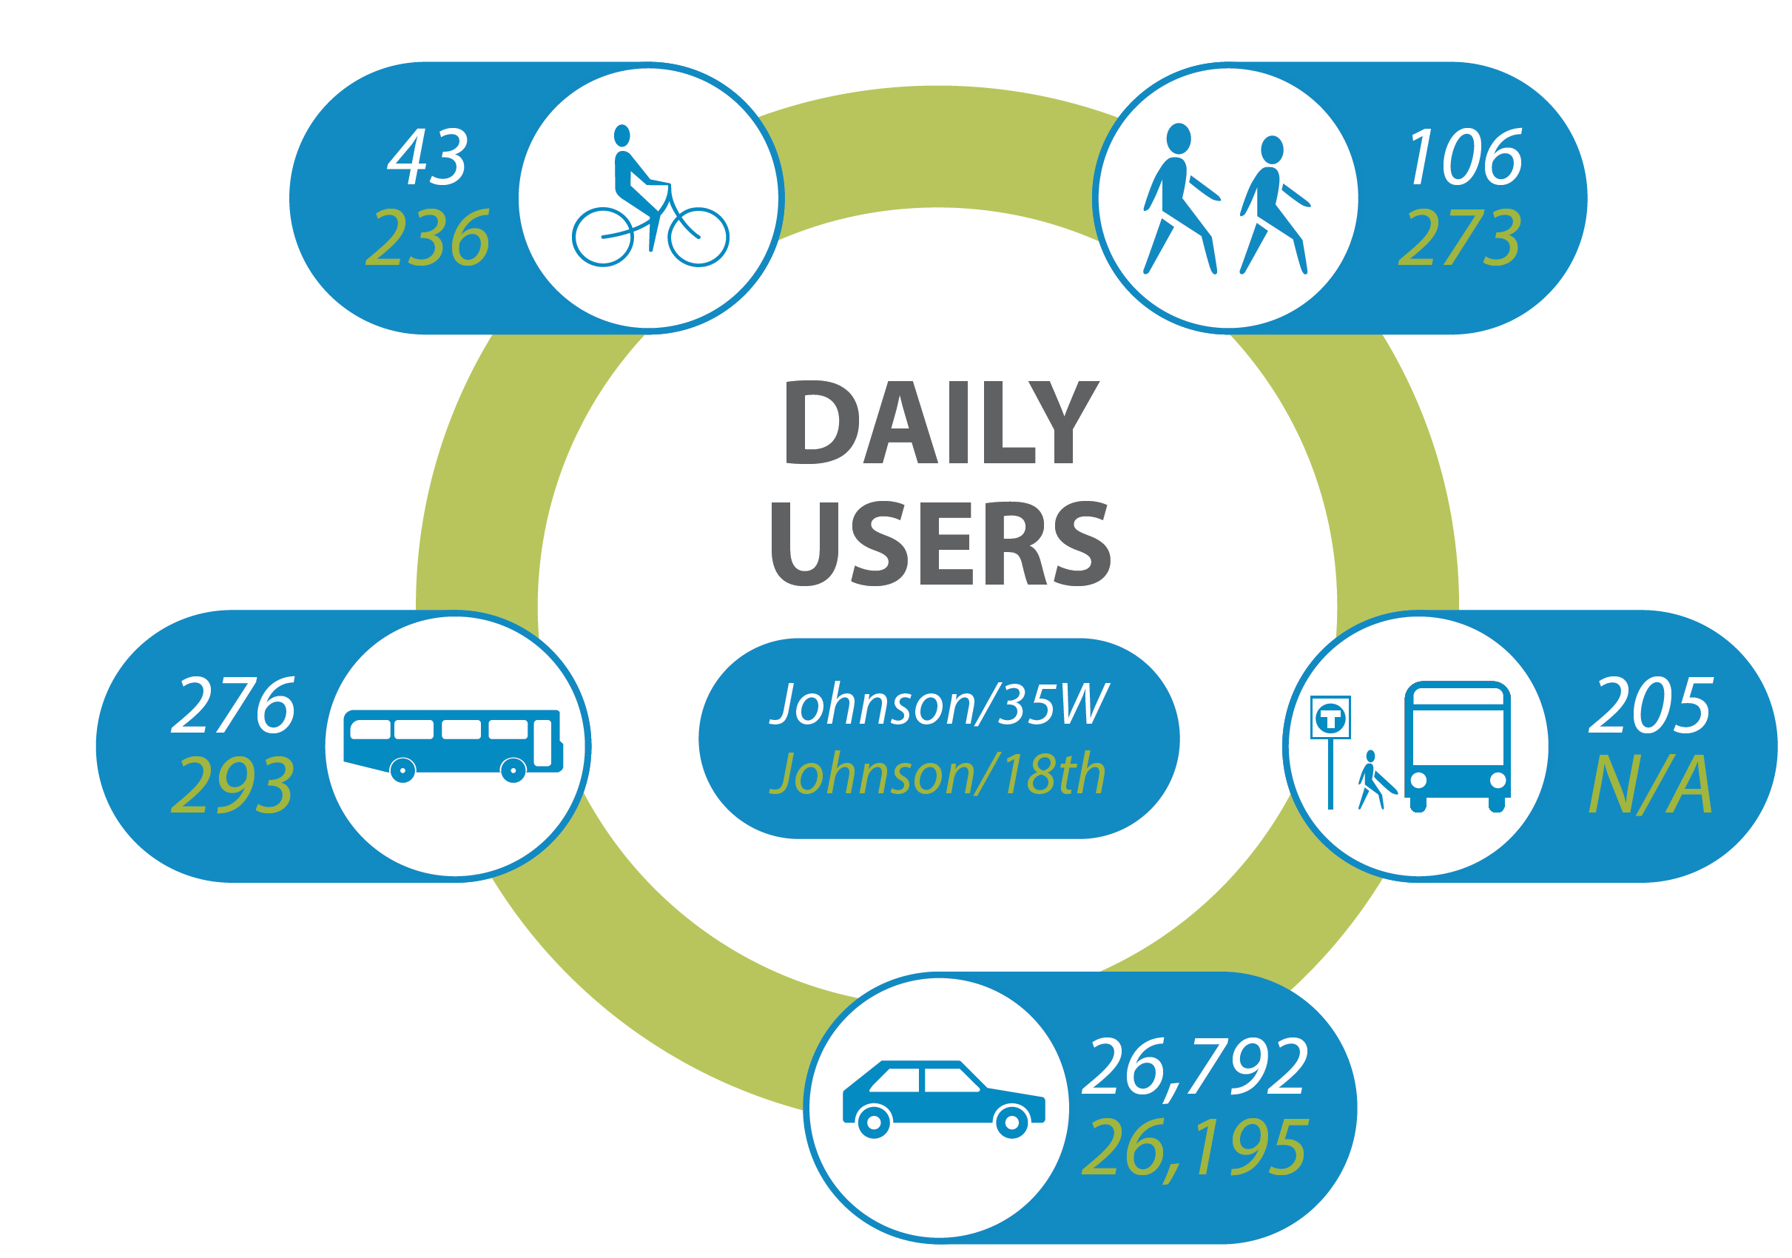
Existing Conditions
Design of intersection no longer meets policy guidelines and best practices
Outdated transportation and signal infrastructure
Walking or rolling across the intersection is uncomfortable and does not meet ADA standards
No existing space for people to comfortably bike at or near the intersection
Crossing distance poses a safety concern for pedestrians
Lane configuration can cause driver confusion
Bicyclists
Pedestrians
Buses
Transit Riders
Motor Vehicles
Notes:
Intersection design no longer meets policy guidelines and best practices
Outdated transportation and signal infrastructure
Degraded pedestrian crossing infrastructure
Lack of bicycle accommodations
Safety concerns

Slide 8
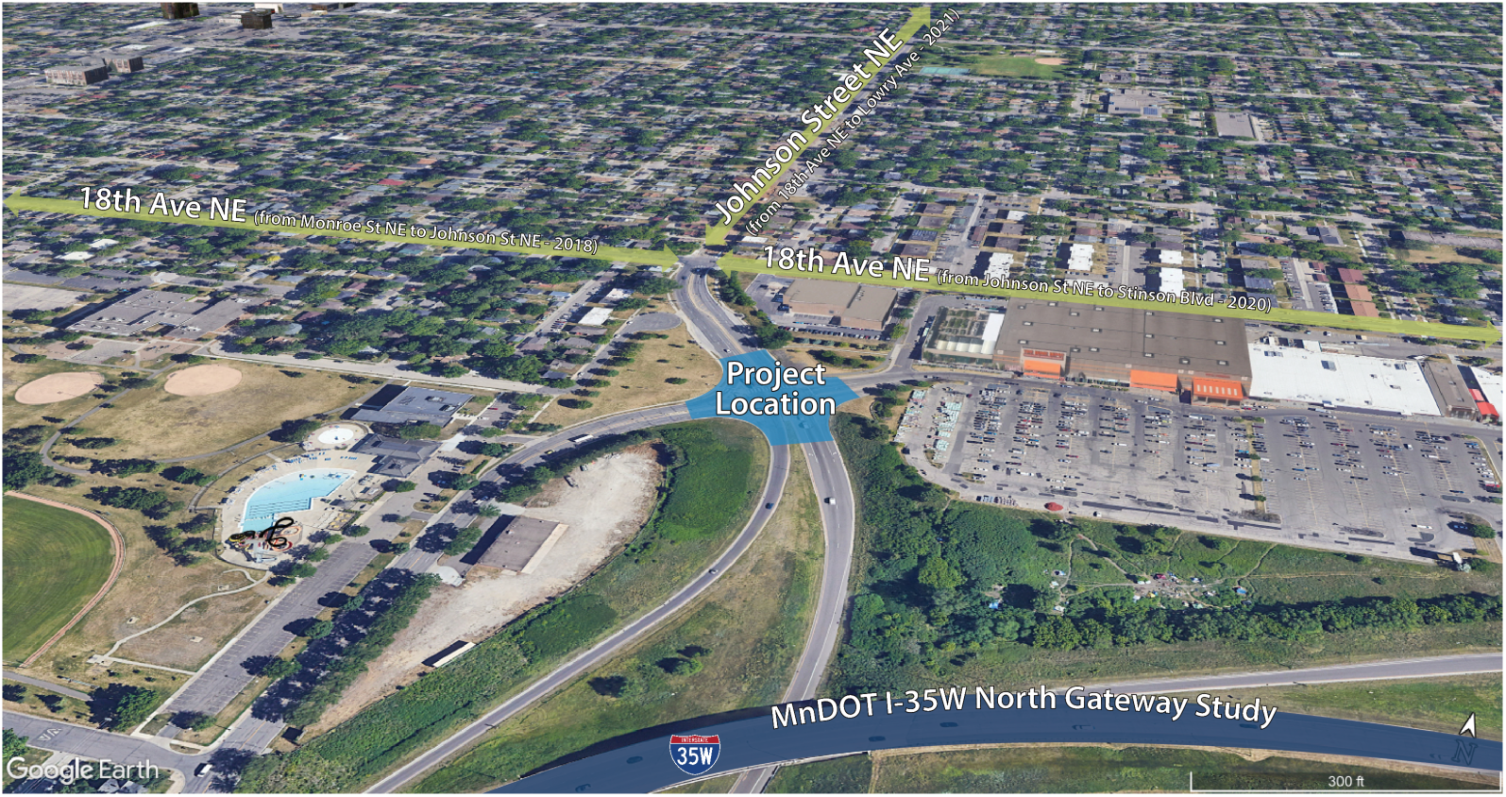
Nearby Projects
Notes:
City Street Reconstruction Projects
The City has recently completed street reconstruction projects as shown in green on the map
State Transportation/Safety Study
MnDOT is currently undertaking the I-35W North Gateway Study from Park Ave. in Minneapolis to County Rd. C in Roseville. The goal of the study is to develop a vision for the study area and identify potential future transportation improvements for pedestrians, bicyclists, motorists, passengers and transit riders.

Slide 9
Data Collection & Analysis
Data Collection
August 2022 at Johnson St NE / I-35W interchange and Johnson St NE / 18th Ave NE intersection
24 hour counts of pedestrians, transit riders, bicyclists, buses, and motor vehicles
Analysis
Intersection Control Evaluation (ICE) Report used to inform how intersection will perform under different scenarios
Several intersection types and configurations were modeled
Factors considered:
Growth and development
Transit needs
Pedestrian/Bicycle facilities
Crash History
Traffic volumes – intersection capacity
Community needs
Intersection safety

Slide 10
Results
Results showed 2 viable reconstruction options (shown on next slide) to handle current and future intersection needs.
Both options provide:
Upgraded pedestrian and bicycle facilities
Reduced crossing distances
New pavement
Accommodations for the future vision of Johnson to the south
Connection to existing bike facilities on 18th Ave
Continued evaluation of both options with the project goals in mind

Slide 11
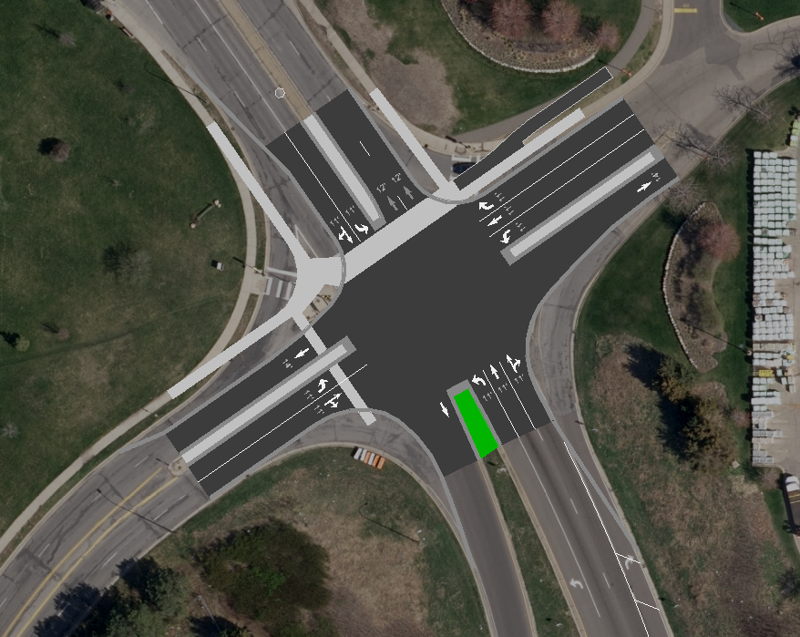
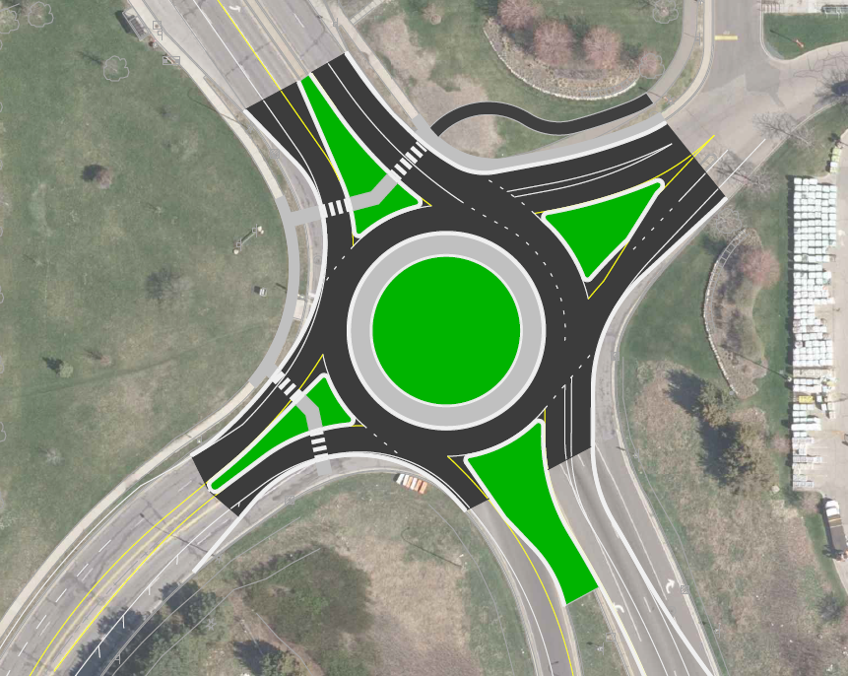
Preliminary Concepts
1
2
New Signal
Tighten corners to reduce turning movement speeds
Reduce crossing distance
Narrow lanes to calm traffic speeds
Roundabout
Pedestrian crossing one direction of travel at a time
Geometry forces slower traffic speeds
Reduces right angle and head on collisions conflicts

Slide 12
Next Steps
Notes:
Public Works will review feedback, data, and planning guidance, and then develop a preferred intersection design option
The preferred option will be shared at a second open house (early 2023, date TBD) and on the project website for feedback
Public Works will recommend the preferred option to City Council
The last steps are final design and then construction

Slide 13
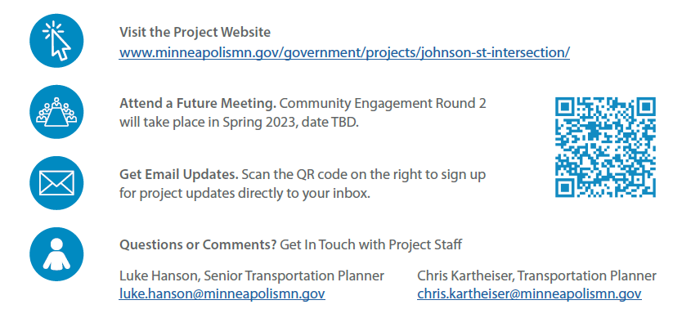
Stay Involved / Questions

