Slide 1
1st Ave South Reconstruction Project
Special Assessment – Informational meeting
March 6th 2024

Slide 2
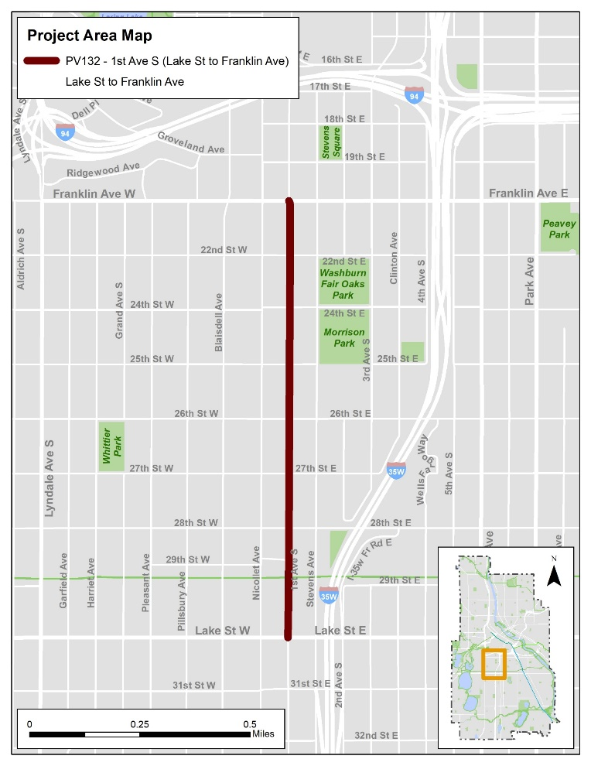
1st Ave S Roadway & Bridge Reconstruction
Project Limits
1st Ave S from Lake Street to Franklin Ave
Construction Schedule
Begin in May 2024, substantially complete by December 2025
Notes:
The limits of the reconstruction are from Lake St – Franklin Ave.

Slide 3
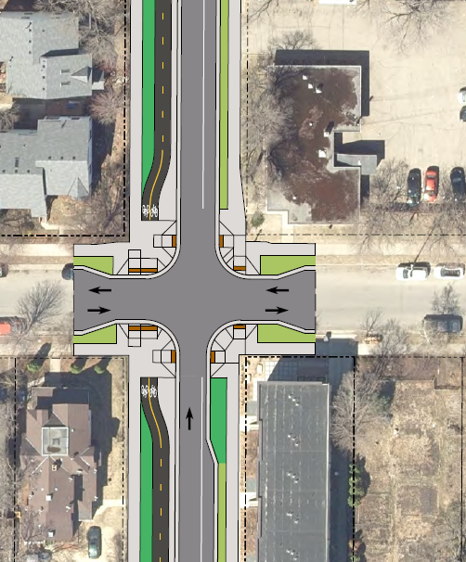
Project Improvements
Reconstruct street for the full right-of-way width (sidewalk to sidewalk)
Two-way sidewalk level bikeway on west side
Parking/loading bays where feasible
1st Ave Bridge replacement over Greenway
Sanitary sewer replacement
Pedestrian street Lighting
ADA and traffic signal upgrades
Green stormwater infrastructure

Slide 4
City of Minneapolis
Street Reconstruction
Special Assessment
Notes:
This portion of the presentation contains information related to the proposed street reconstruction and related special assessments. A special assessment is a tax collected by the City for improvements or services the City provides that benefit your property.

Slide 5
Agenda
How assessments are calculated
Interest rate and term of the assessment
Payment options
Public hearing
Resources and contact information
Notes:
The topics we’ll cover includes:
(advance 1) How assessments are calculated
(advance 1) Interest rates and the term of the assessment
(advance 1) Payment options
(advance 1) The public hearing
(advance 1) resources and contact.

Slide 6
How assessments are calculated

Slide 7
Components of the calculation
Influence area
Uniform assessment rate
Notes:
We use two components to calculate special assessments for street reconstruction projects in Minneapolis.
The first component (advance once) is the influence area, or more specifically, the square footage of your property which is within the influence area of the project.
The second component (advance once) is the uniform assessment rate for the proposed improvement.

Slide 8
Influence area
x uniform assessment rate
Assessment
Notes:
Assessments are calculated by multiplying the influence area square footage by the uniform assessment rate.
We’ll explain both assessment components in more detail.
=

Slide 9
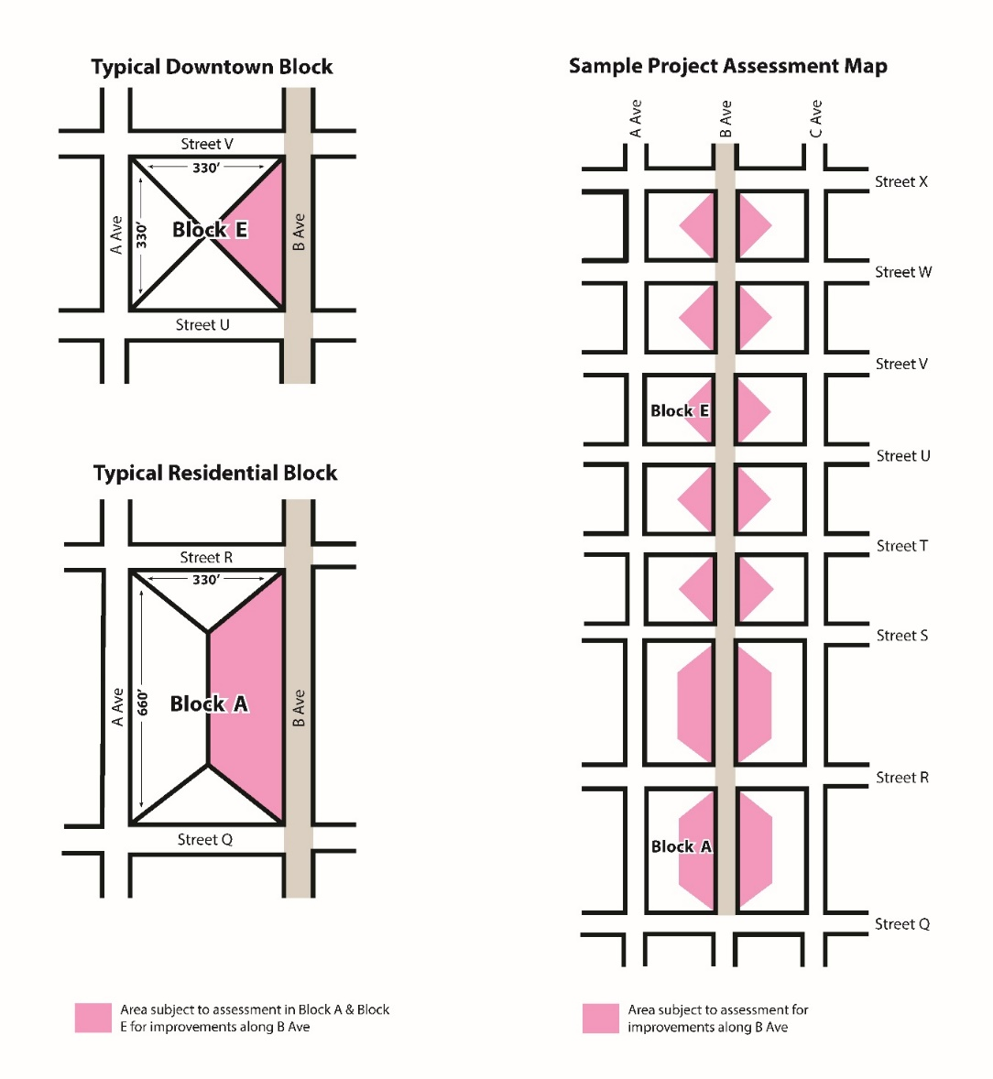
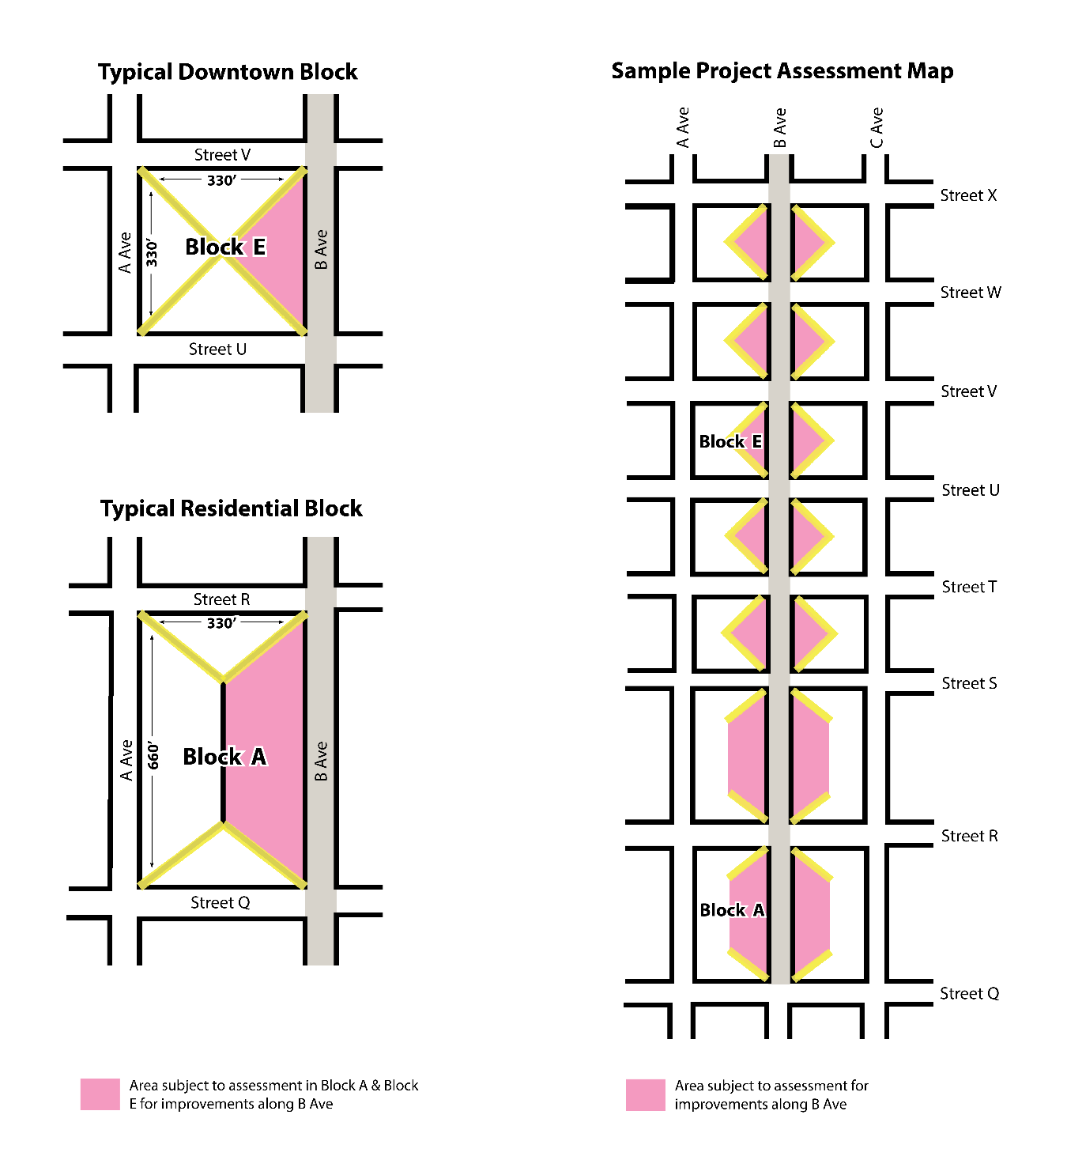
Influence area method
Notes:
The influence area method… (advance 1 slide)
…involves bisecting the angle at each street intersection to create non-overlapping areas of influence.

Slide 10
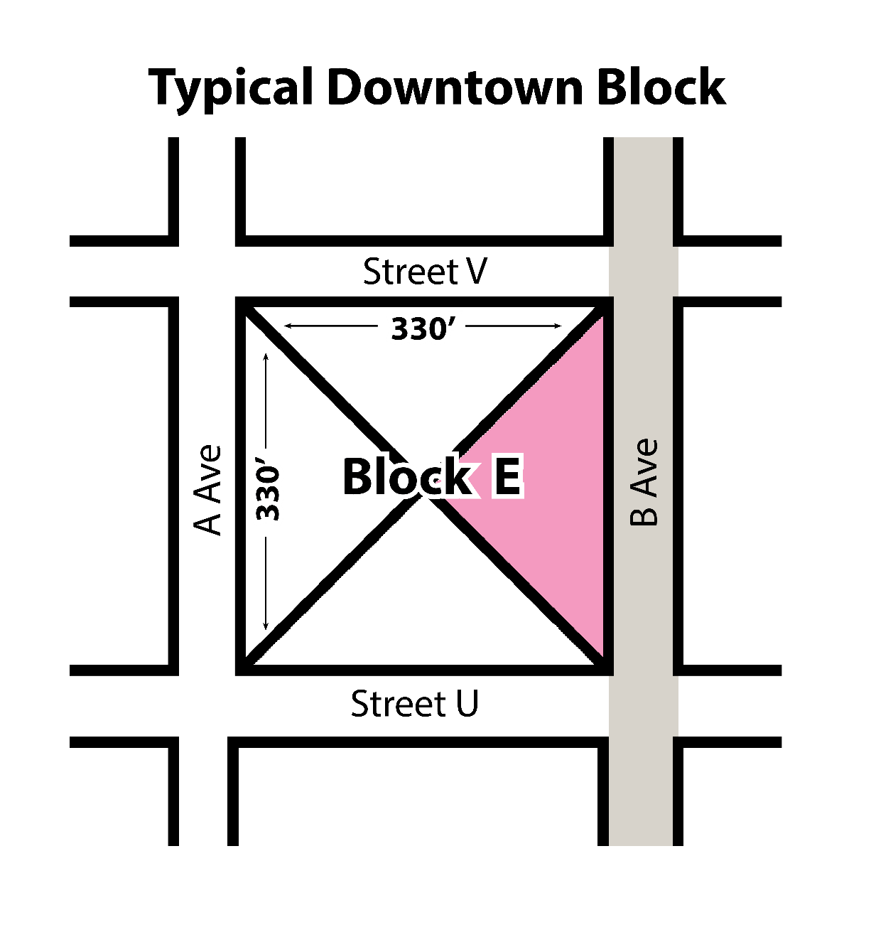
Influence area method
Notes:
Doing this creates four triangular influence areas in the typical downtown block example…

Slide 11
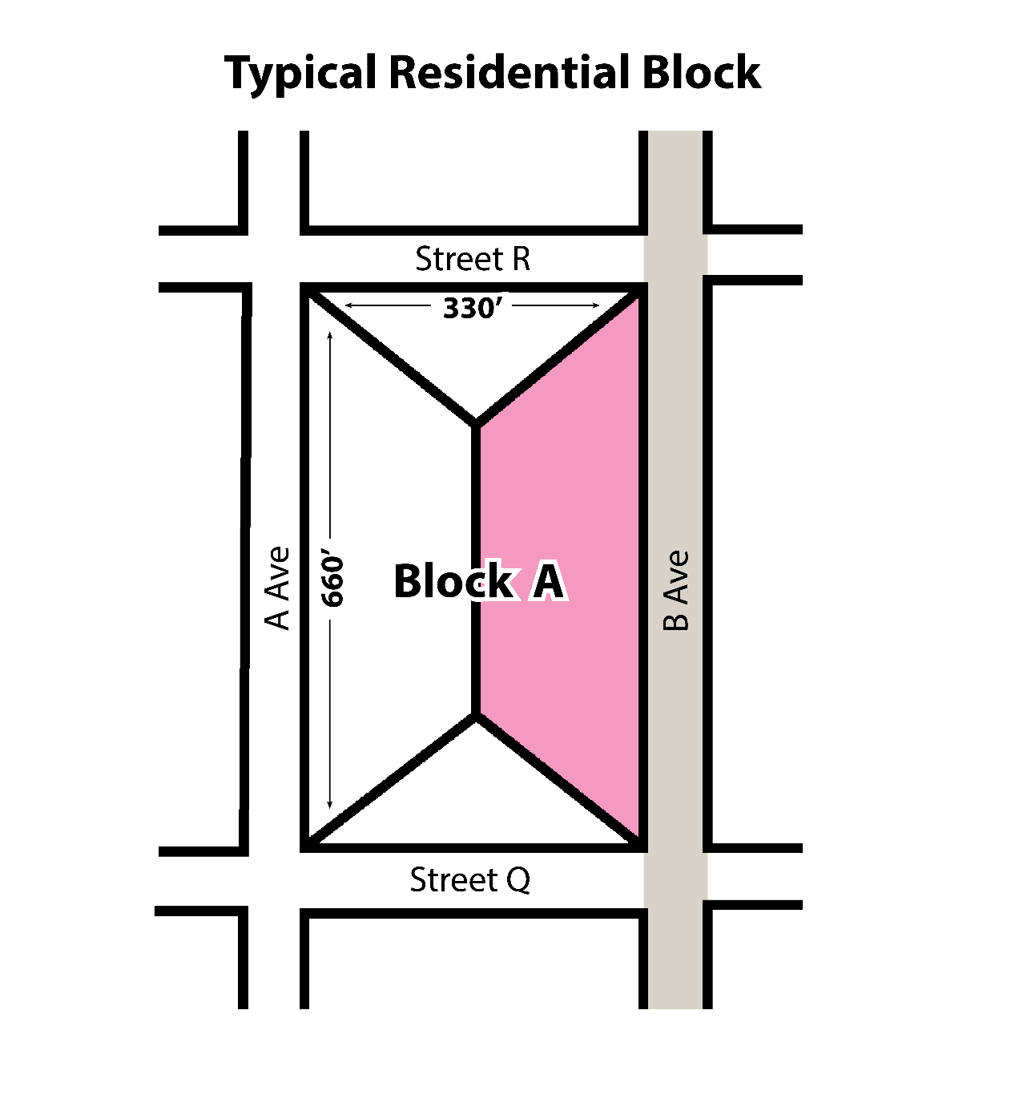
Influence area method
Notes:
…and trapezoidal and triangular shapes in the typical residential block example.

Slide 12
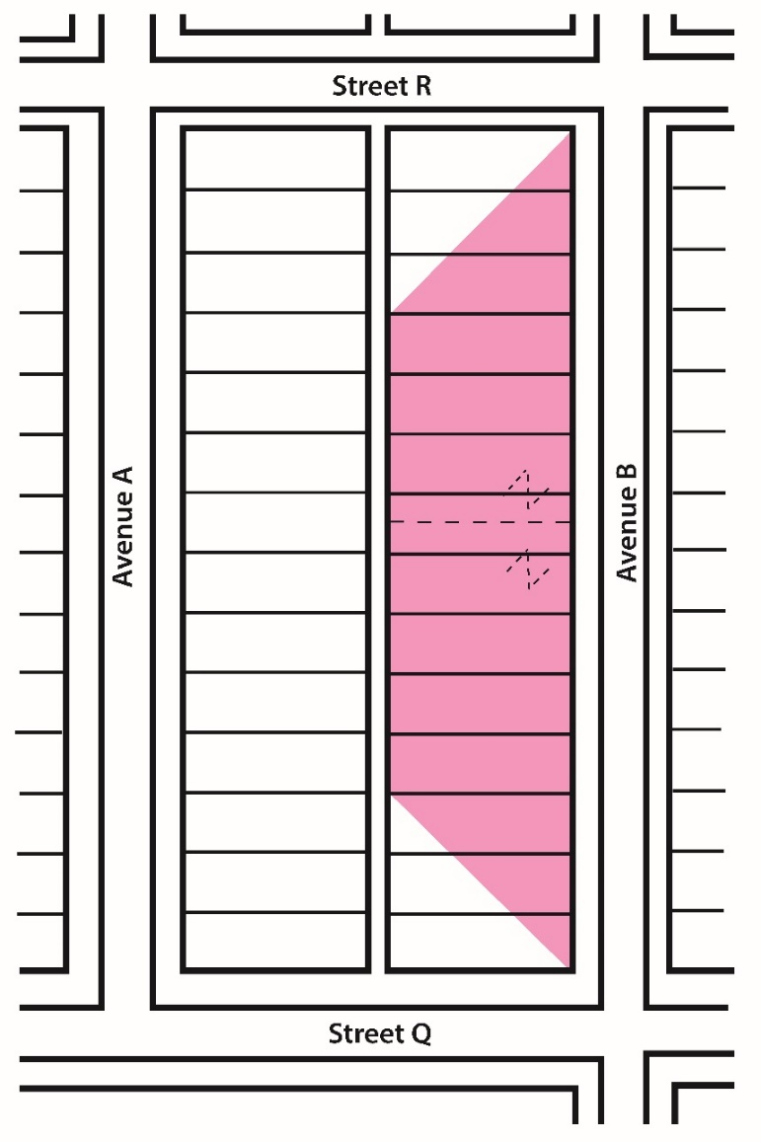
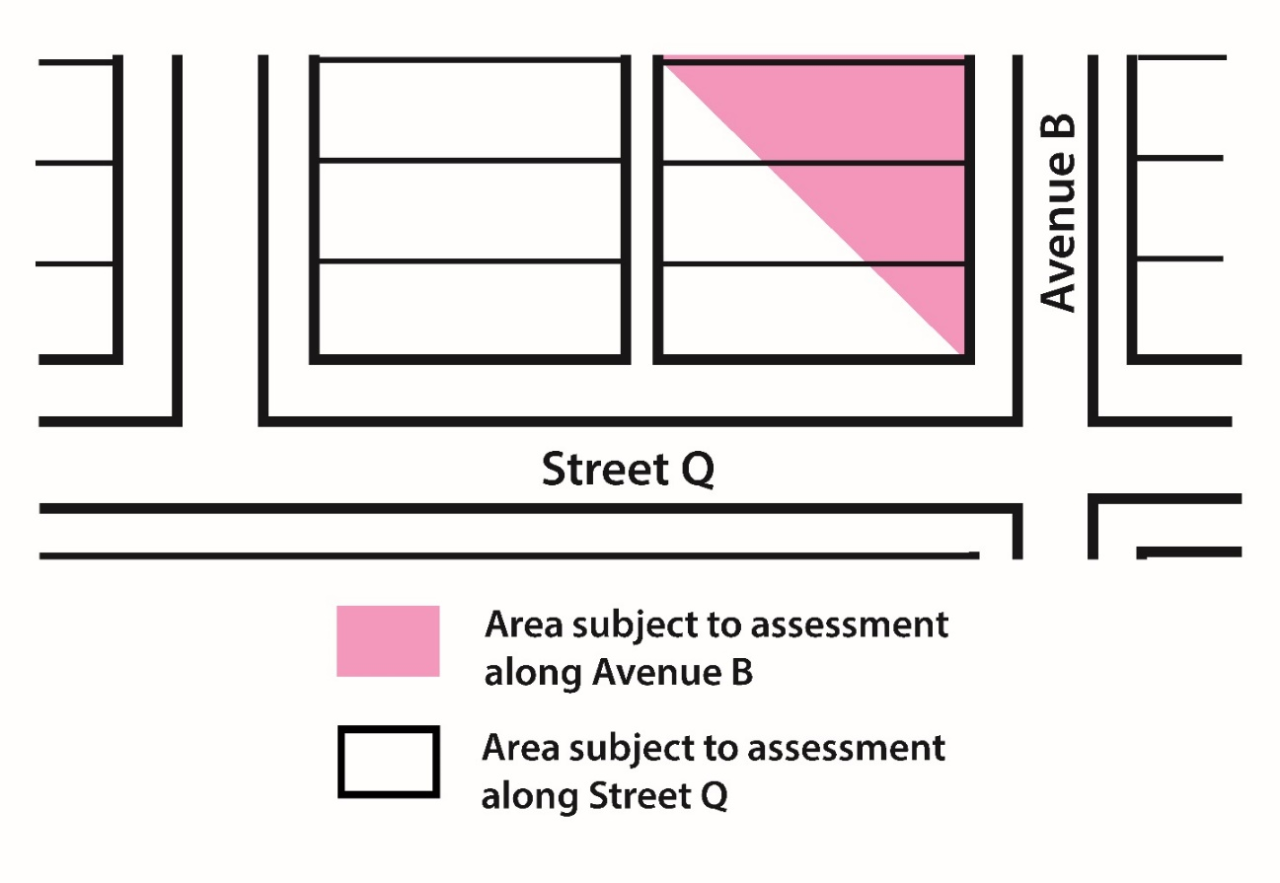
Influence area example
Corner example
Notes:
This example shows what an influence area might look like for a typical residential street.
If you look at the typical residential block example, if Avenue “B” was being reconstructed, the property area within the pink trapezoid would be within the influence area of the project and subject to assessment.
The influence area method is a way to uniformly assess properties based on square footage that is fair to corner properties. (advance 2)
In the example of the rectangular corner property, only the relatively small pink area will factor into their assessment for Avenue B.
However, they will be assessed based on the white area when Street Q is improved.

Slide 13
Uniform assessment rates
2024 rate for street reconstruction
$2.83 per square foot
$0.95 per square foot
non-residential properties
residential properties
Notes:
City Council reviews, updates and approves uniform assessment rates every year.
The uniform assessment rate is the same for each type of improvement for all similar projects throughout the City. The 2024 uniform assessment rate for (advance 1) street reconstruction projects is $2.83 per square foot for non-residential properties, and (advance 1) 95 cents per square foot for residential properties.
Again, the uniform assessment rate is the rate that is multiplied by the influence area to calculate each assessment amount.

Slide 14
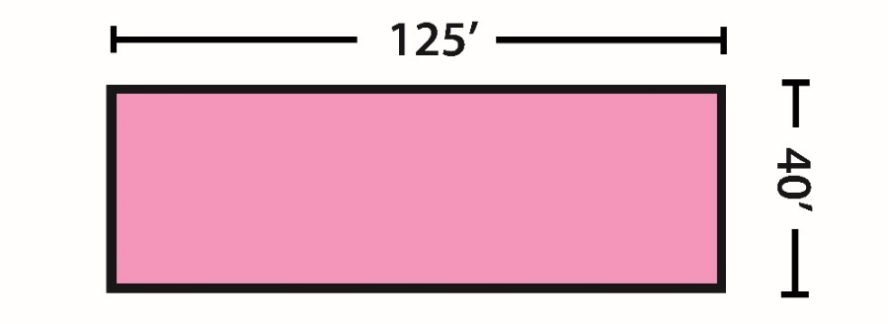
Sample residential assessment calculation
Sample lot for the calculation is 40’ x 125’
Length x width = total square footage
40’ x 125’ = 5,000 sq ft
Multiplied by UAR ($0.95)
5,000 sq ft x .95 = $4,750
Notes:
This example shows how your assessment is calculated using the dimensions of a standard residential lot where all of the parcel is within the influence area of the project.
The total square footage is determined by multiplying the length by the width. This number is then multiplied by the uniform assessment rate. (advance 3 slides and pause)

Slide 15
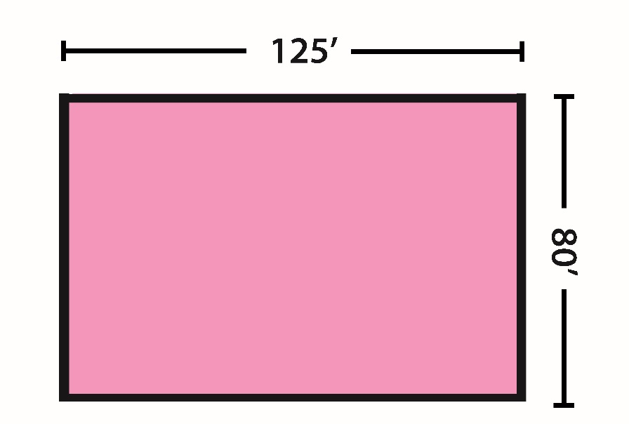
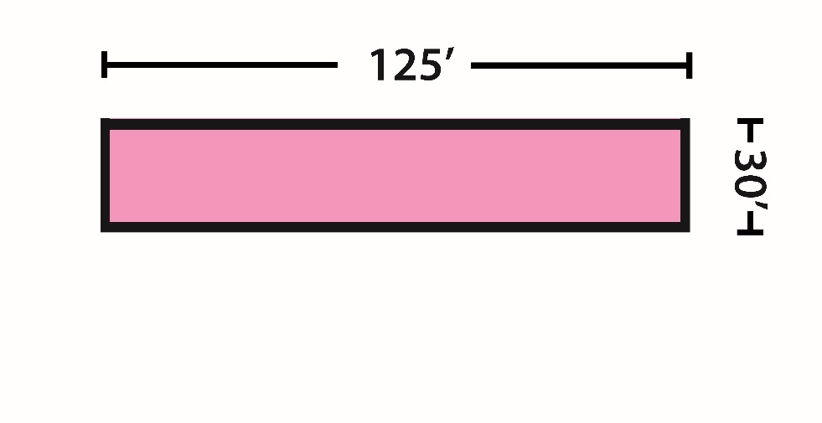
Assessment amounts may vary
Notes:
(advance 2 slides) Your assessment amount may vary from your neighbors’. That is because not all parcels are the same size…

Slide 16
Assessment amounts may vary
Notes:
(advance 1 )...and some parcels are not located entirely within the project influence area.

Slide 17
Assessment terms and interest rates

Slide 18
Assessment term
Assessments
over $150
Assessments of $150 or less
Collected over a 20-year period
Collected in 1 year
Notes:
Hennepin County collects assessments over (advance 1) $150 in 20 annual payment installments. Assessments of (advance 1) $150 or less in one installment.
To pay the assessment on these terms, you do not need to take any action in advance.
Hennepin County collects payment through
property taxes after they’re levied. Typically, this begins the year after construction.

Slide 19
%
Current Interest Rates (For reference only)
20-year assessment
1-year assessment
4.78%
interest rate
(2024 collection)
3.71%
interest rate
(2024 collection)
Notes:
Once they’re levied, simple interest is added to the assessments at a rate that’s tied to the sale of municipal bonds used to fund the project.
The Minneapolis finance department calculates the interest rate each year in December for projects that will be levied .
The current interest rate for assessments to be levied in 2024 (advance 1) is 4.78% for 20-year assessments and (advance 1) 3.71% for 1-year assessments.
The interest is calculated based on the unpaid balance, so the interest amount decreases slightly each year.
Special assessments for the reconstruction on Hennepin Ave will not be levied in 2024, so interest rates are not yet known. We anticipate the finance department calculating those interest rates in December 2025.

Slide 20
Sample assessment amount was $4,750
$4,750 / 20 = $237.50 (annual principal amount)
Simple interest is added
Principal plus interest payment of approximately $465 the first year.
Sample annual payment
Notes:
Using the sample assessment calculation previously shown, (advance 1)
divided up over 20 years would result in an annual principal payment of $237.50. (advance 1)
Adding in simple interest (advance 1)
would bring the first annual payment to approximately $465, each year the amount will decrease, until the last annual payment of approximately $250. (advance 1).

Slide 21
Payment options

Slide 22
Prepayment option 1
Pay in full before the assessment is levied
Eliminates any interest payments
Payment must be in full – no partial payments accepted
Must request a prepay invoice
To request a prepay invoice: email pwspecialassessments@minneapolismn.gov or call 612-673-2401 and leave a message
Notes:
If you wish to prepay the assessment to avoid paying interest, you can request a prepay invoice by contacting the special assessment office. Note that you must pay in full. We do not accept partial payment.
Request a prepay invoice by emailing the special assessment office at pwspecialassessments@minneapolismn.gov. Or you can call 612-673-2401 and leave a message. Your public hearing notice also lists this contact information.

Slide 23
Prepayment option 2
Pay off the remaining balance (at any time during the assessment)
Eliminates future years’ interest
Call the Special Assessment office to find out the payoff amount
Notes:
If you do not prepay the assessment, you can still pay off the remaining balance at any time during the assessment to avoid paying some of the interest.
To get the payoff amount, you can contact the special assessment office.

Slide 24
Deferment option
Available to:
Seniors 65 or older
Individuals with permanent and total disability
Military personnel ordered into active military service
Other factors
Property must be homesteaded
Combined assessment must be $750 or more
Does not reduce or remove the assessment
Notes:
There is a deferment option available to:
Seniors 65 and older
People with permanent and total disability
And certain military personnel.
To qualify for this program:
the property must be homesteaded
and the assessment must be $750 or more
Please note that this only defers the payment until some point in the future. It does not reduce or cancel the assessment.
The amount is added to your property taxes and continues to accrue interest until the property is sold, or changes homestead status.
For more information on this program, please contact the Special assessment office.

Slide 25
Public hearing

Slide 26
Public hearing
We’ll hold a public hearing for public comments
Date and time is listed in the public hearing notice you received
Learn ways to participate in these meetings: minneapolismn.gov/government/meetings
Notes:
We’ll hold a public hearing to allow for public comment on this proposed project.
Your public hearing notice lists the date and time of the hearing.
To learn ways to take part in the public hearing, visit minneapolismn.gov/government/meetings. You are not required to take part in the public hearing.

Slide 27
Public hearing
If you wish to object to the assessment, you can:
Appear in person to provide live comments to the committee
Submit a letter to the City Clerk’s office at the address listed in your public hearing notice
Send an email to councilcomment@minneapolismn.gov
Using any of these options preserves your right to appeal to District Court
Notes:
If you wish to object to the assessment, you may:
Appear in person
Write a letter and send it to the City Clerk’s office
or Email the City Clerk at councilcomment@minneapolismn.gov
We must receive your written objection no later than the date and time of the public hearing. Note that contesting using any of these options preserves your right to appeal to district court.

Slide 28
Contact information and resources

Slide 29
Contact information
For assessment questions
Email: pwspecialassessments@minneapolismn.gov Phone: 612-673-2404
For questions about the project
Contact the Project manager:
Stephanie Malmberg
Stephanie.malmberg@minneapolismn.gov
612-673-3365
Project website:
www.minneapolismn.gov/projects/HennepinSouth
Notes:
If you have general questions about the assessment process, or questions specific to your property's assessment, please email the Special Assessment Office at pwspecialassessments@minneapolismn.gov for more information.
You can also call the Special Assessment Office at 612-673-2401 and leave a voicemail. Staff will return your call as soon as possible.
If you have questions related to the project, such as:
When the work will be done.
Access issues during construction.
And so on.
Please contact the project manager at the number listed on this slide and in your public hearing notice letter.

Slide 30
More resources and common questions
Visit the Special Assessment page on the City of Minneapolis website.
Contact the Special Assessment Office at pwspecialassessments@minneapolismn.gov
Notes:
You can find more information on the City’s special assessment webpage.
There is also a Common questions resource that may answer any questions you might have.
If you still have questions, you can contact the special assessment office.
That wraps up our presentation with information on the special assessments for Hennepin Avenue street reconstruction.

